Slide 1
Form 471 RAL

Slide 2
Table of Contents
Topic | Page
The Basics | 3
Locating the RAL | 6
Accessing a Form to Modify | 8
Submitting RAL Modifications | 14
To Change the Contact Person for the Form | 16
To Modify a Funding Request | 25
To Modify the BEN | 45
To Modify the Related Entities | 52
Viewing Submitted Modification Requests | 59

Slide 3
The Basics

Slide 4
What is a RAL?
A RAL is also known as a Receipt Acknowledgment Letter. A RAL is created for each certified Form 471, and contains a summary of the next steps in the application process.
Once an applicant has received a RAL, they may submit corrections to their form that were the result of ministerial and clerical (M&C) errors.
Ministerial and clerical (M&C) errors are defined as data entry errors or mistakes applicants made on the FCC Form 470 or FCC Form 471. Such errors include only the kinds of errors that a typist might make when entering data from one list to another, such as:
mistyping a number
using the wrong name or phone number
failing to enter an item from the source list onto the application
making an arithmetic error

Slide 5
What is the process for a RAL?
The RAL notification and correction process is as follows:
After submitting and certifying an FCC Form 471 in-window , the Form 471 Receipt Acknowledgment Letter (RAL) will appear in the organization’s News feed in EPC.
The RAL contains a summary of the next steps in the application process and provides a link to the FCC Form 471 and to the organization's EPC profile.
The contact person for the form or an authorized user will review the RAL.
The contact person for the form or an authorized user will submit in EPC any necessary RAL corrections for ministerial and clerical (M&C) errors.
NOTE: You can submit modifications up until the time that USAC issues a Funding Commitment Decision Letter (FCDL).
Modifications do not show up in the certified version of the FCC Form 471, and some modifications must be reviewed and approved by Program Integrity Assurance (PIA) during the review of your application.

Slide 6
Locating the RAL

Slide 7
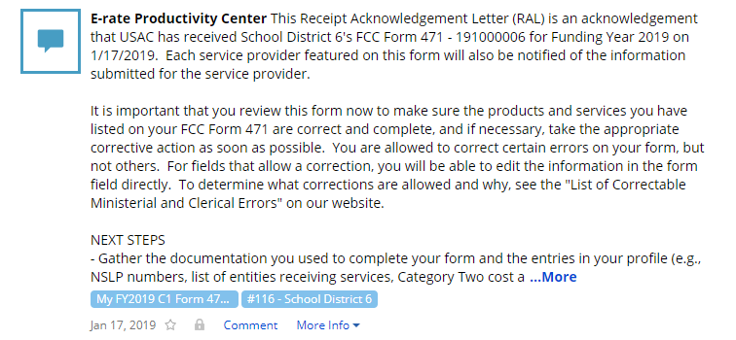
Locating the RAL
The main contact person for any certified Form 471 will receive a RAL in their News Feed
date Form 471 was submitted
How to get here:
1) Landing Page
2) Click on link for independent school or school district
3) Click on “News” link in the menu at the top of the page
① Click on the name of the Form 471 to proceed to the form

Slide 8
Accessing a Form to Modify

Slide 9
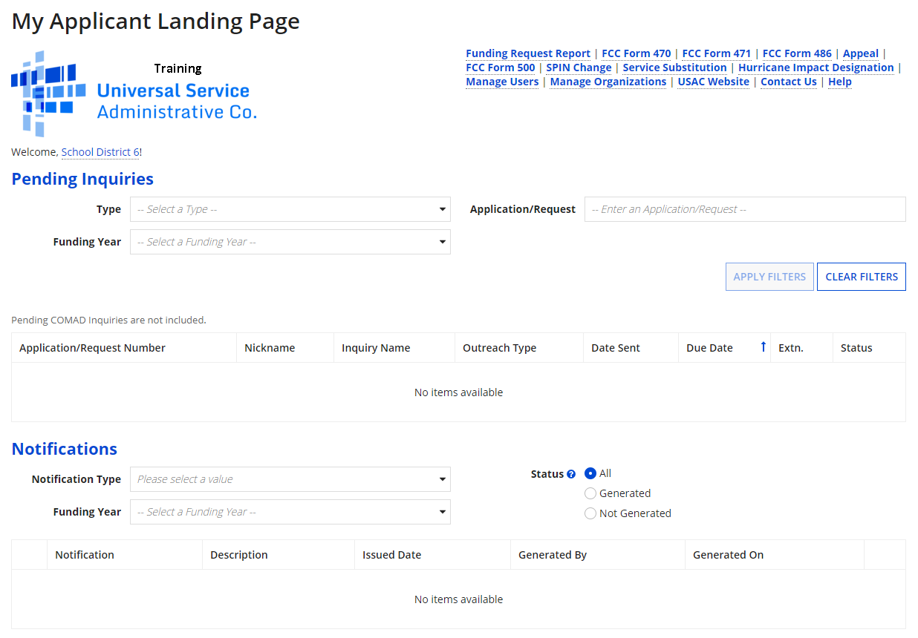
Accessing a Form
① Go to the Landing Page for the organization

Slide 10
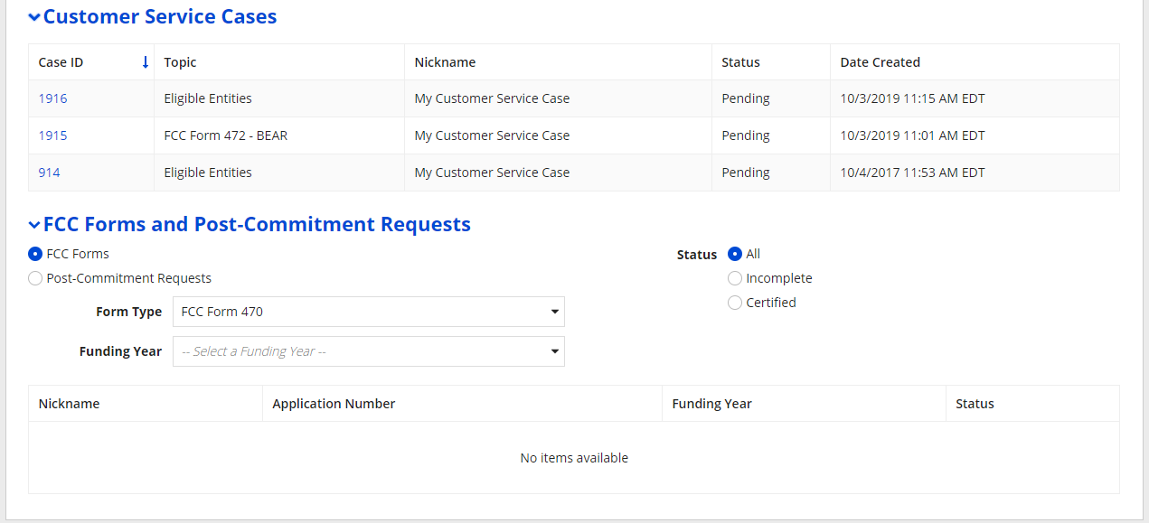
Accessing a Form
② Scroll to the “FCC Forms and Post-Commitment Requests” section of the Landing Page
③ First change the “Form Type” menu to display “FCC Form 471” and then select the Funding Year

Slide 11
Accessing a Form
④ Click on the link for a certified Form 471

Slide 12
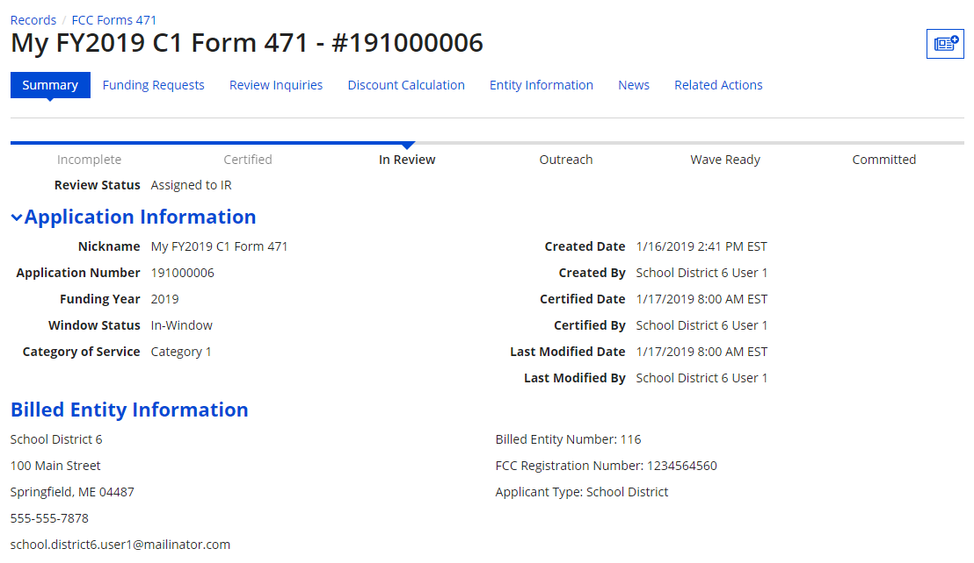
Accessing a Form
⑤ On the summary page for the Form 471, click on the “Related Actions” link

Slide 13
Accessing a Form
⑥ Click on the “Submit Modification Request (RAL)” link

Slide 14
Submitting RAL Modifications
Note that any modifications you make are specific to this FCC Form 471. For example, if you modify information for the billed entity or one of its related entities, the information would be modified for this form only and the request does not update that entity's profile in EPC.

Slide 15
Submitting Modifications
Available RAL modifications fall into two general categories: Application Details and Entity Details

Slide 16
To Change the Contact Person for the Form

Slide 17
Form Contact
① Click on the “APPLICATION” button

Slide 18
Form Contact
② Select “Application Details” from the sub-category menu

Slide 19
Form Contact
③ Click on the “CONTINUE” button

Slide 20
Form Contact
④ Click on the “EDIT APPLICATION” button to edit application details such the main contact person and holiday contact info

Slide 21
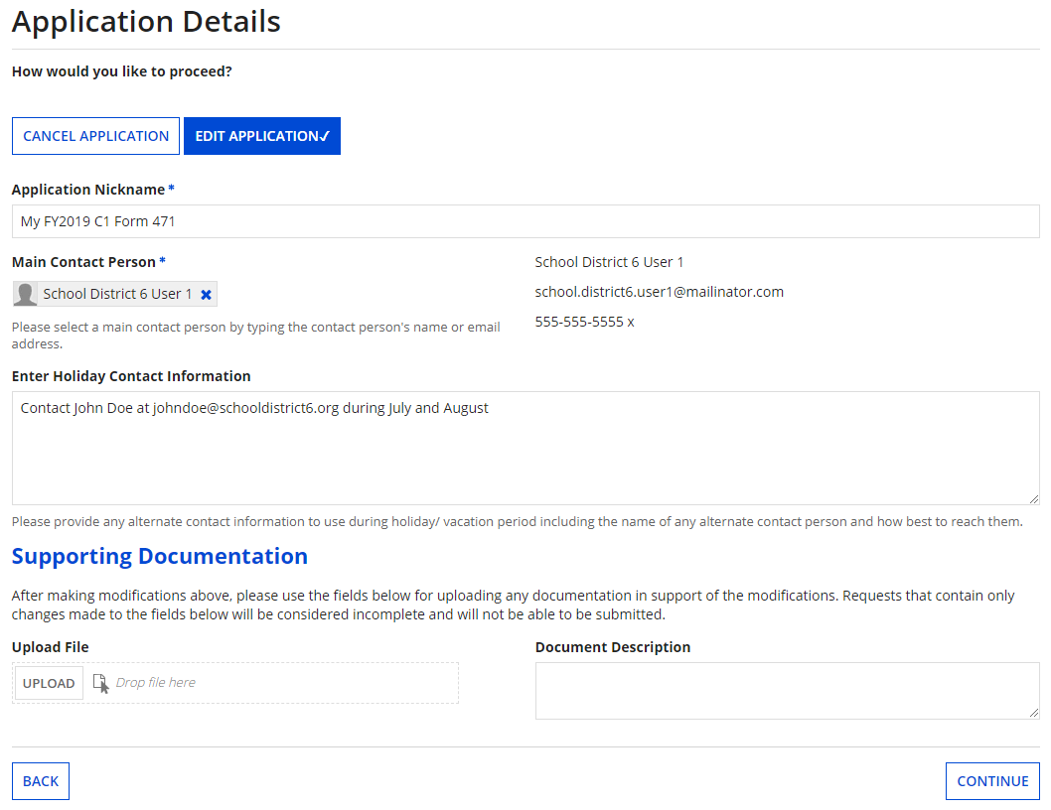
Form Contact
The application details display

Slide 22
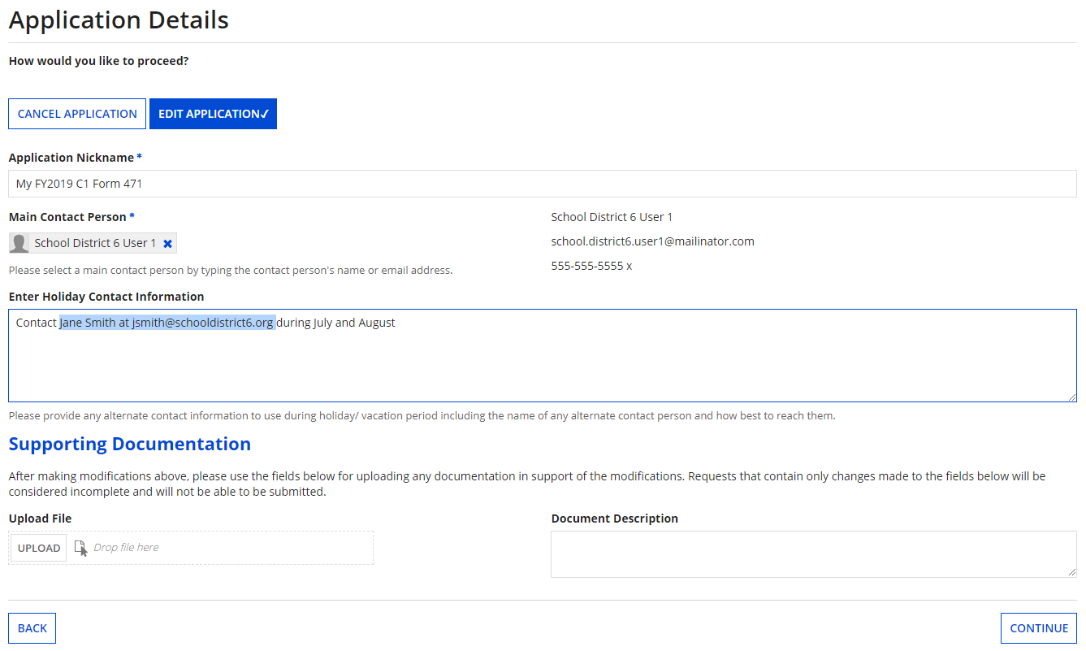
Form Contact
⑤ Modify information as necessary
⑥ Then click on the “CONTINUE” button

Slide 23
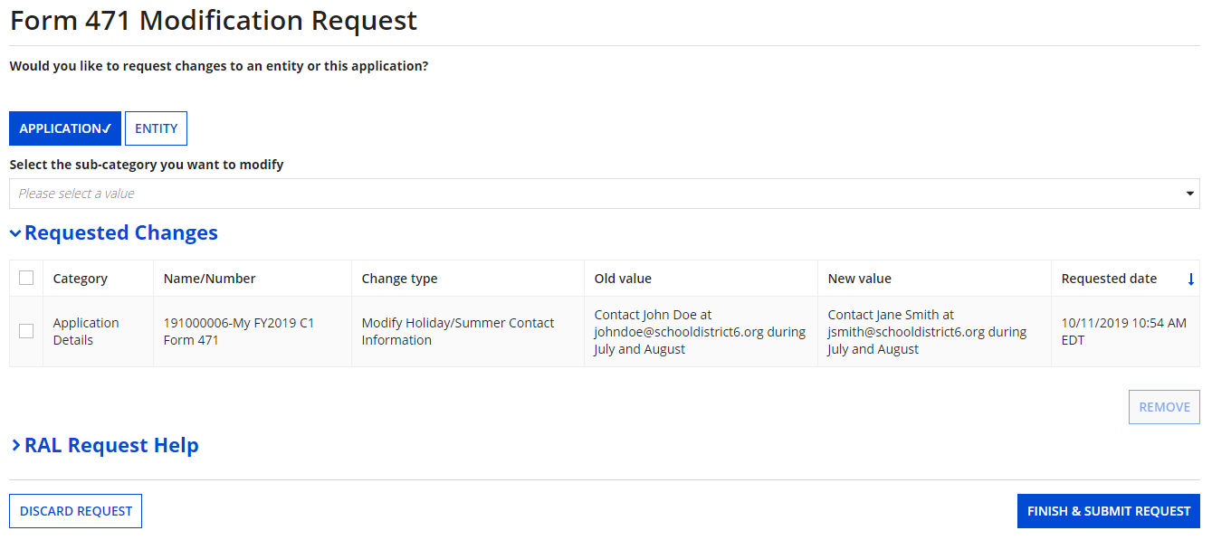
Form Contact
Your requested change will display
Check the check box for a change and then click on the “Remove” button to discard a requested change
⑦ Click on the “FINISH & SUBMIT REQUEST” button

Slide 24
Form Contact
⑧ Click on the “YES” button to submit the change
skip to page 59 in this guide for info on viewing modifications

Slide 25
To Modify a Funding Request
Examples of modifications include adding a missing FRN, editing FRN line items (such as costs and product information), and editing the FRN key information (such as the narrative).

Slide 26
Funding Request Details
① Click on the “APPLICATION” button

Slide 27
Funding Request Details
② Select “Funding Request Details” from the sub-category menu

Slide 28
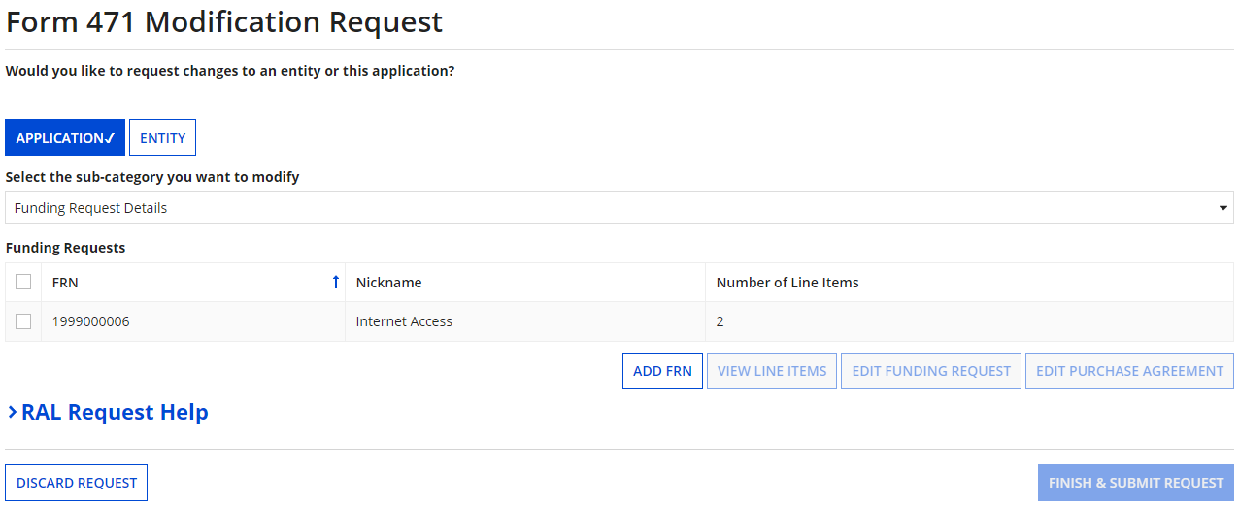
Funding Request Details
A list of FRNs for this Form 471 displays

Slide 29
Funding Request Details
To add a new FRN:
Click on the “ADD FRN” button to add an FRN. Follow the steps as prompted to create key information for a new FRN such as you did when creating the Form 471.

Slide 30
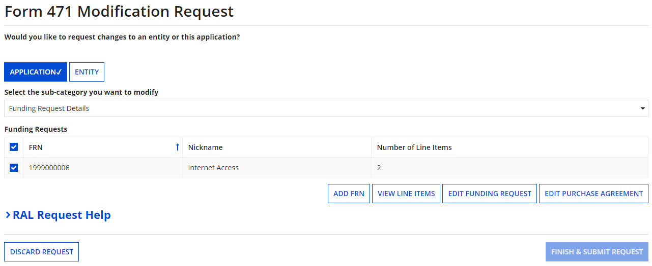
Funding Request Details
A
B
C
To modify an existing FRN:
Click on the checkbox for an FRN to modify, and then…
A
To view and edit existing line items, click on the “VIEW LINE ITEMS” button → go to the next page
B
To edit the FRN, click on the “EDIT FUNDING REQUEST” button → skip to page 36
C
To edit contract info, click on the “EDIT PURCHASE AGREEMENT” button → skip to page 41

Slide 31
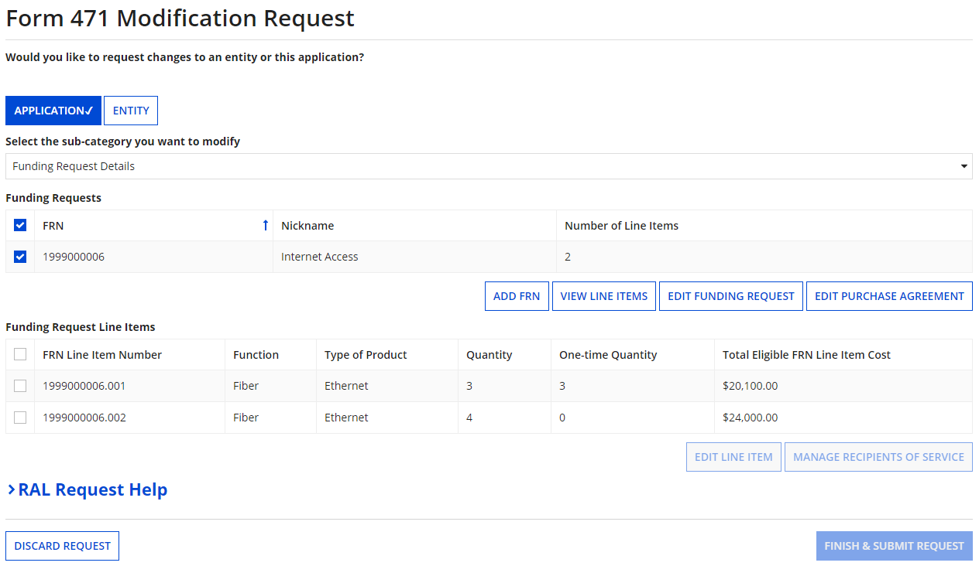
Line Items
To view and modify existing FRN line items:
A
① If you clicked on the “View Line Items” button, the line items for that FRN will display

Slide 32
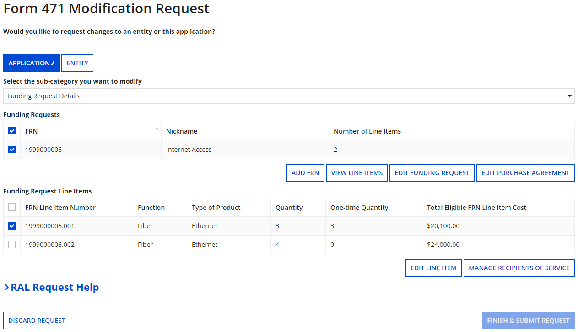
Line Items
A
② Select the check box for a line item, and click on either the “EDIT LINE ITEM” or “MANAGE RECIPIENTS OF SERVICE” button (whichever is appropriate for the change you need to make)

Slide 33
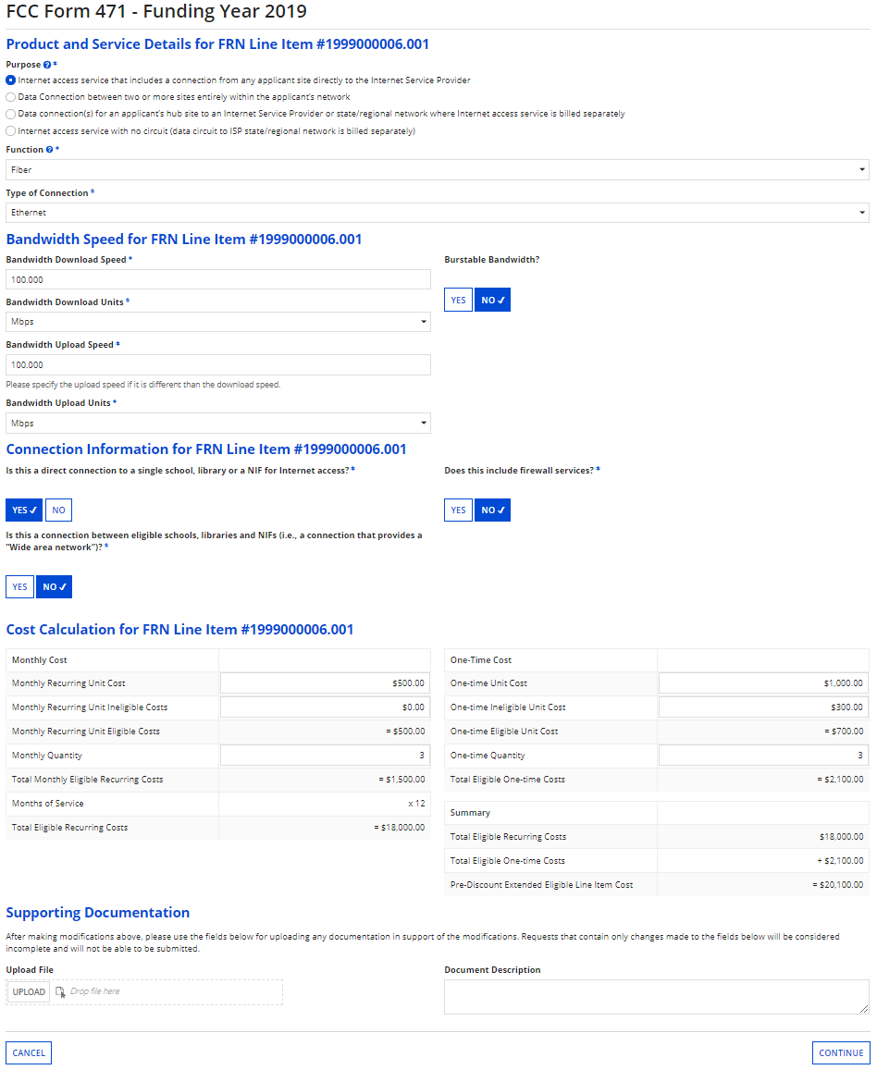
Line Items
Example of “Edit Line Item” screen: change the originally entered cost and/or service or product info
③ Make your desired change
A
④ Upload documentation supporting the requested change
A
⑤ Click on the “CONTINUE” button to proceed
A

Slide 34
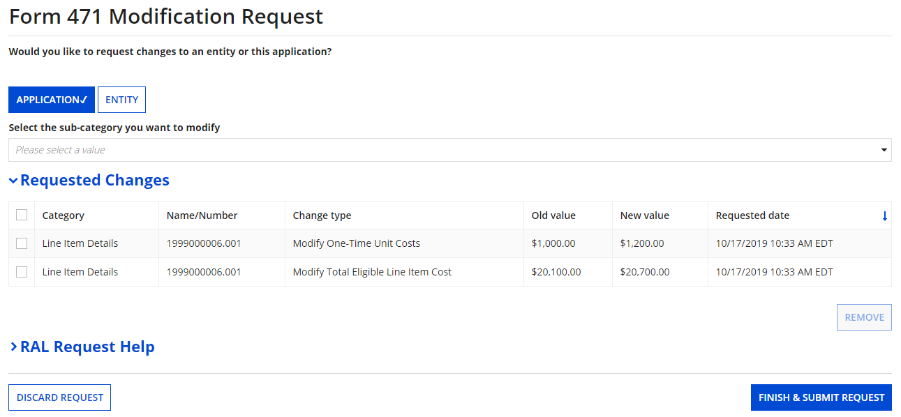
Line Items
Your requested change will display
⑥ Click on the “FINISH & SUBMIT REQUEST” button
A

Slide 35
Line Items
⑦ Click on the “YES” button to submit the change
A
skip to page 59 in this guide for info on viewing modifications

Slide 36
Funding Request
To edit the Funding Request:
Click on the “CANCEL FRN” button to remove an FRN from your Form 471
B
① If you clicked on the “Edit Funding Request” button, click on the “EDIT FRN KEY INFORMATION” button to proceed

Slide 37
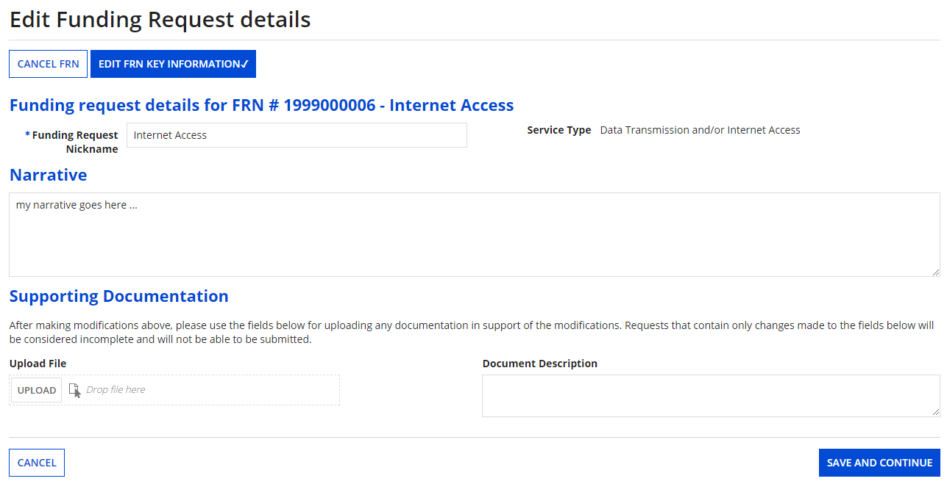
Funding Request
The FRN displays

Slide 38
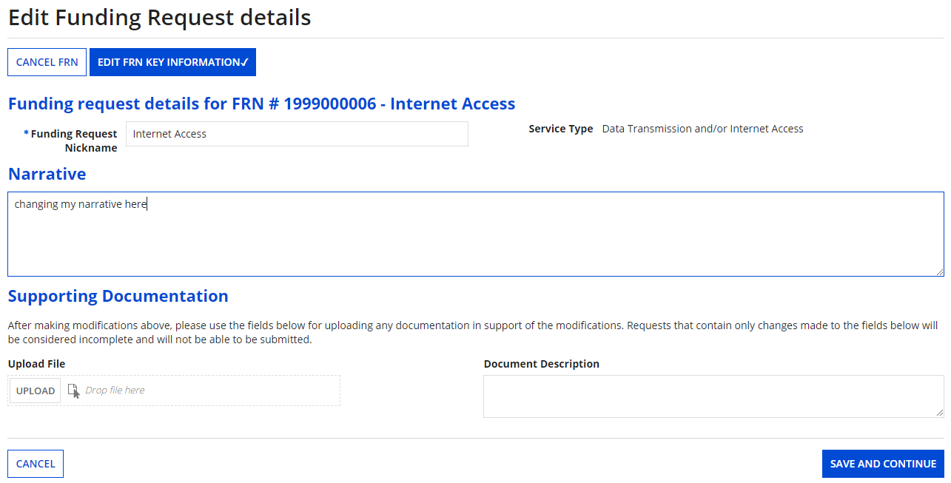
Funding Request
B
② Make any necessary changes
B
③ Then click on the “SAVE & CONTINUE” button to proceed

Slide 39
Funding Request
Your requested change will display
Check the check box for a change and then click on the “REMOVE” button to discard a requested change
④ Click on the “FINISH & SUBMIT REQUEST” button
B

Slide 40
Funding Request
⑤ Click on the “YES” button to submit the change
B
skip to page 59 in this guide for info on viewing modifications

Slide 41
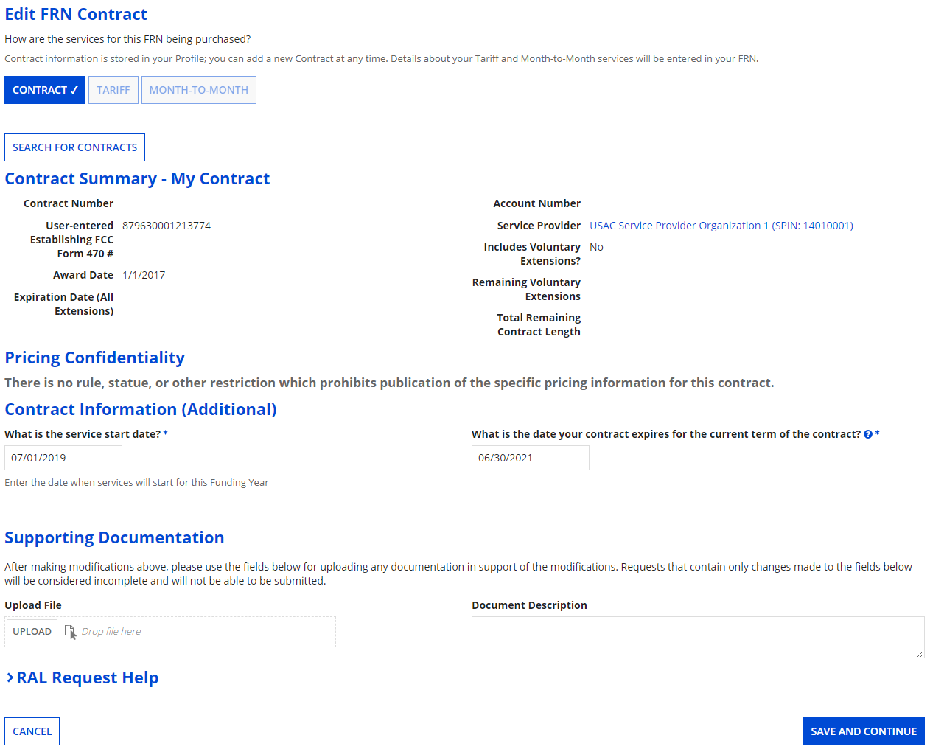
To edit the contract information:
Purchase Agreement
C
① If you clicked on the “Edit Purchase Agreement” button, make any necessary changes (such as the contract being used or the start and end date)

Slide 42
Edit Purchase Agreement
C
② Click on the “SAVE & CONTINUE” button to proceed

Slide 43
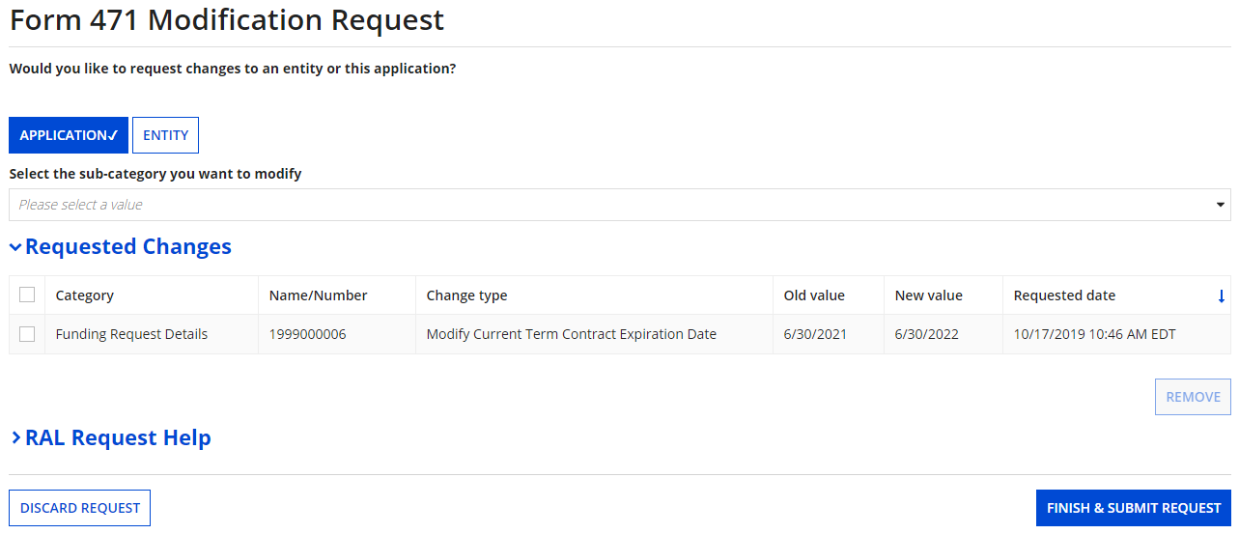
Purchase Agreement
Your requested change will display
Check the check box for a change and then click on the “REMOVE” button to discard a requested change
③ Click on the “FINISH & SUBMIT REQUEST” button
C

Slide 44
Edit Purchase Agreement
④ Click on the “YES” button to submit the change
C
skip to page 59 in this guide for info on viewing modifications

Slide 45
To Modify the BEN
Examples of modifications include adding a related entity to the Form 471 (such as a child school building of a district) and editing the BEN profile information that was included on the Form 471 (such as its physical address).

Slide 46
BEN
① Click on the “ENTITY” button

Slide 47
BEN
② Click on the “BEN” button

Slide 48
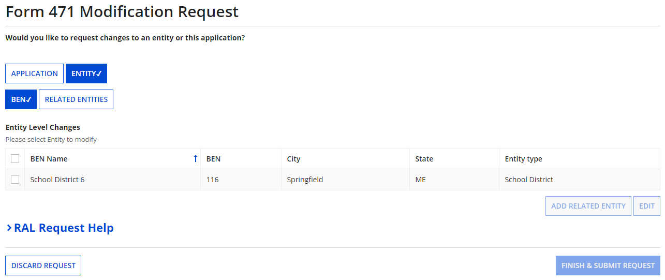
BEN
③ Select the check box for the BEN

Slide 49
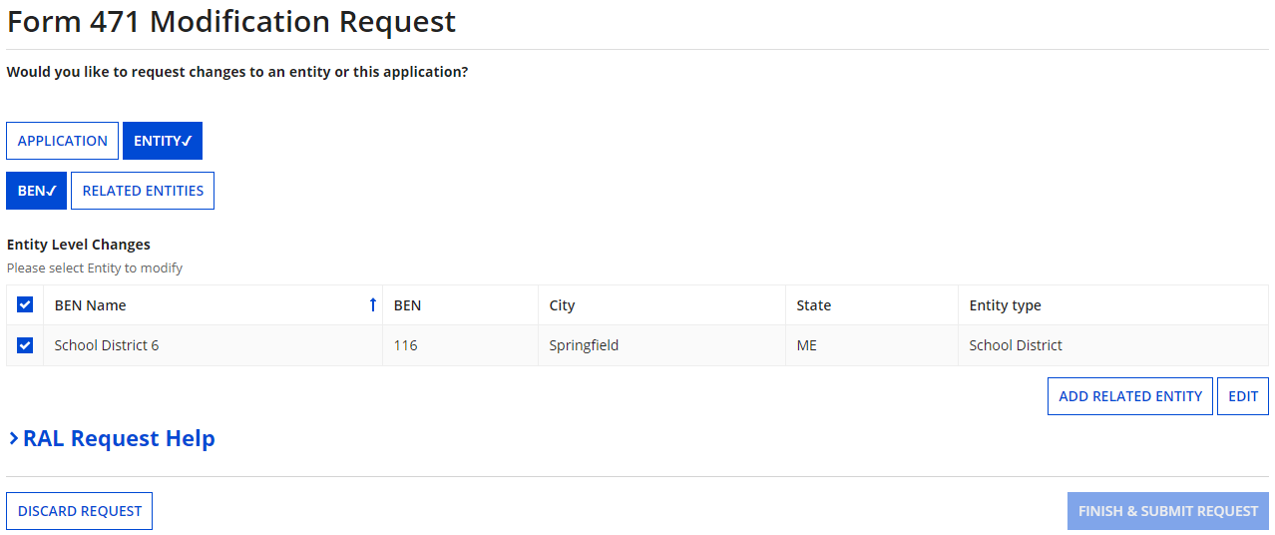
BEN
④ Click on either the “ADD RELATED ENTITY” button to add an entity that was left off the FRN or the “EDIT” button to edit the information pulled from the profile to the Form 471. Follow the system prompts to make changes.

Slide 50
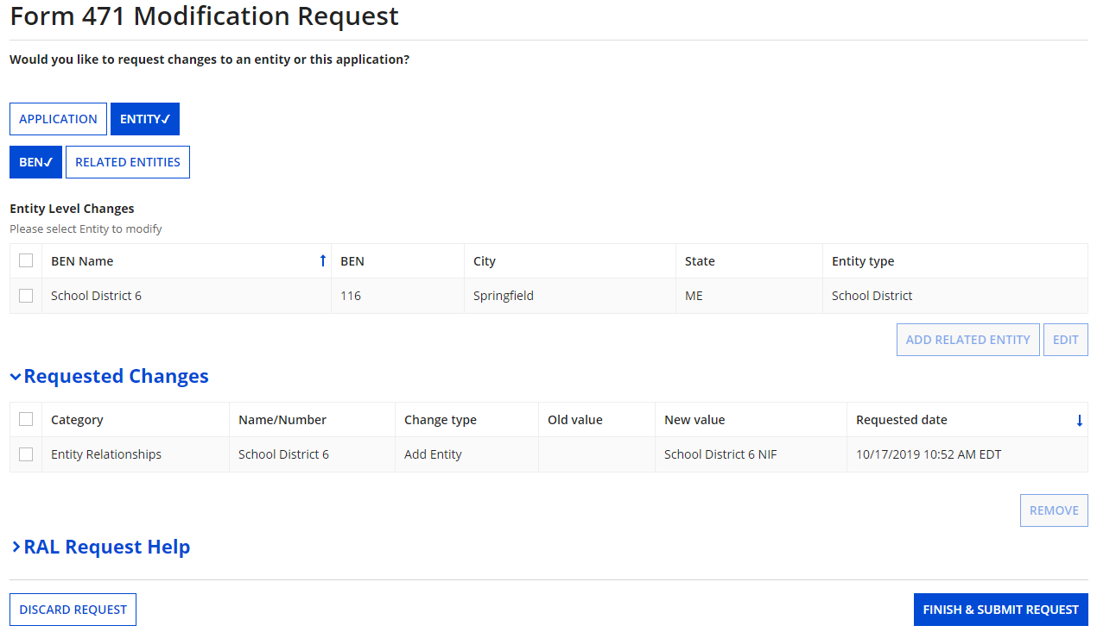
BEN
⑤ Click on the “FINISH & SUBMIT REQUEST” button

Slide 51
BEN
⑥ Click on the “YES” button to submit the change
skip to page 59 in this guide for info on viewing modifications

Slide 52
To Modify the Related Entities
Examples of modifications include removing a related entity from the Form 471 (such as a child school building of a district) and editing the profile information for child entities (such as their physical address).

Slide 53
Related Entities
① Click on the “ENTITY” button

Slide 54
Related Entities
② Click on the “RELATED ENTITIES” button

Slide 55
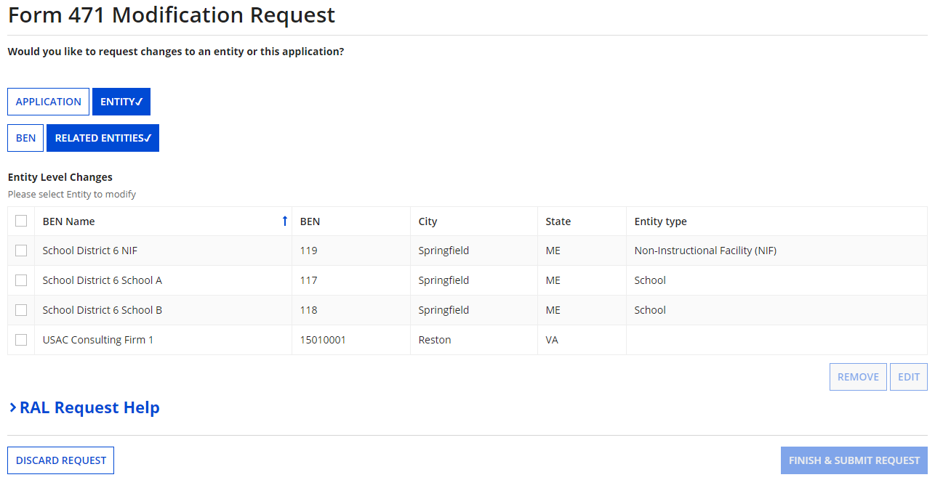
Related Entities
③ Select the check box for an entity

Slide 56
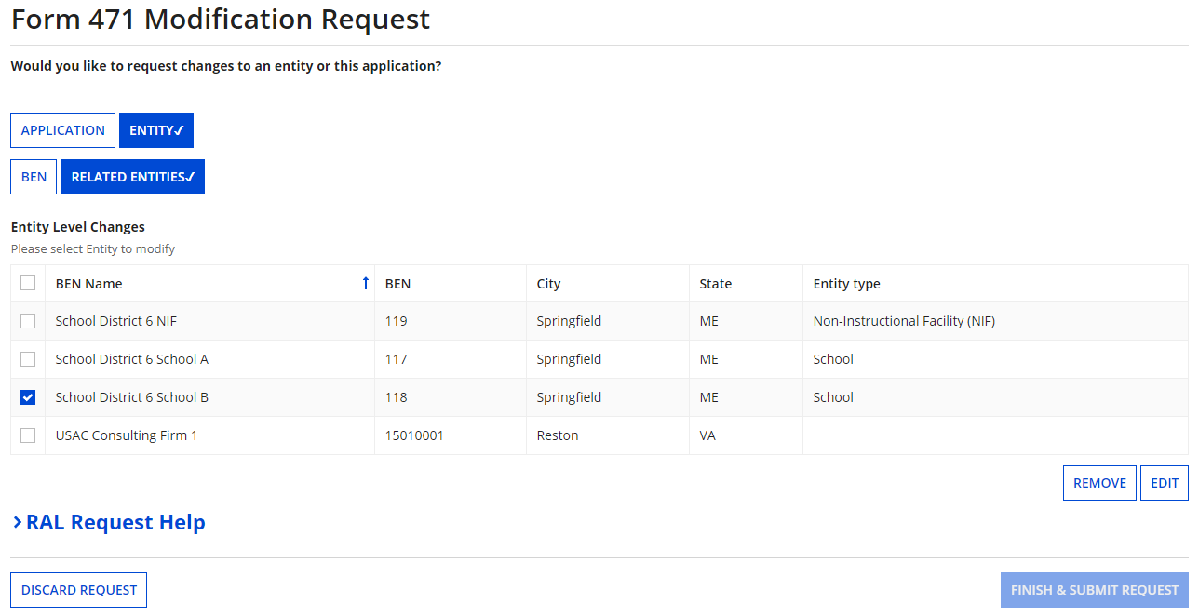
Related Entities
④ Click on either the “REMOVE” button to remove the entity from the FRN or the “EDIT” button to edit the information pulled from the profile to the Form 471. Follow the system prompts to make changes.

Slide 57
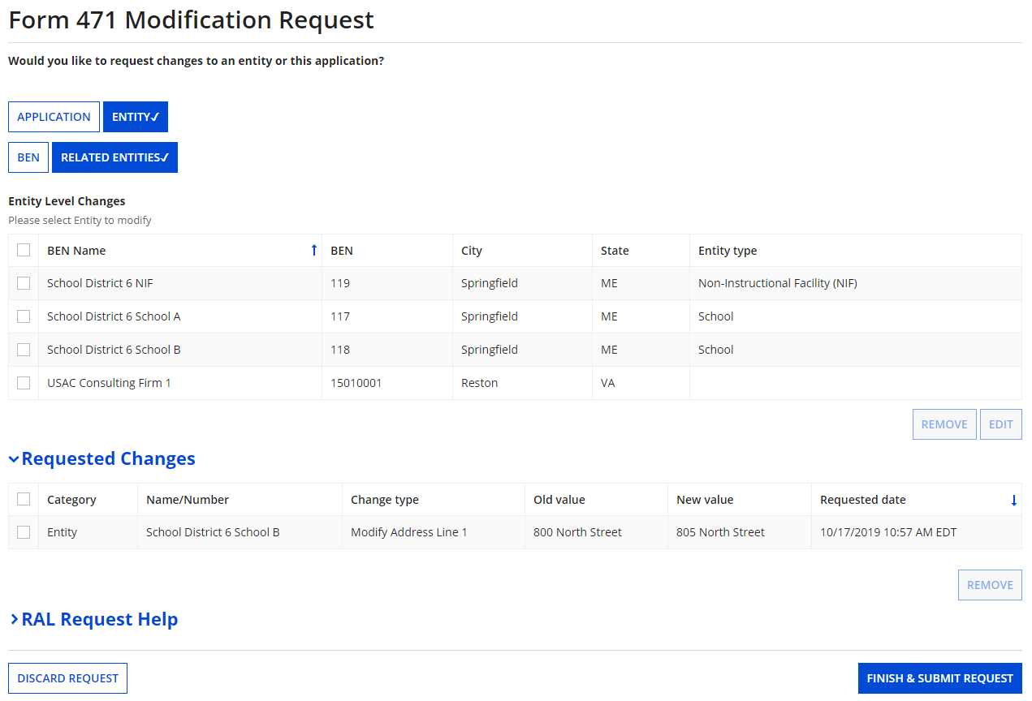
Related Entities
⑤ Click on the “FINISH & SUBMIT REQUEST” button

Slide 58
Related Entities
⑥ Click on the “YES” button to submit the change
go to the next page in this guide for info on viewing modifications

Slide 59
Viewing Submitted Modification Requests

Slide 60
Viewing Modifications
Each time you submit a modification request you are taken back to the “Related Actions” screen for that form. From there you might choose to immediately view the requests you have already submitted, or you can complete the steps to view submitted requests at any time from any screen within EPC.
① Click on the “Reports” tab

Slide 61
Viewing Modifications
② Click on the “My Submitted Modification Requests (RAL)” link

Slide 62
Viewing Modifications
③ Select the Funding Year

Slide 63
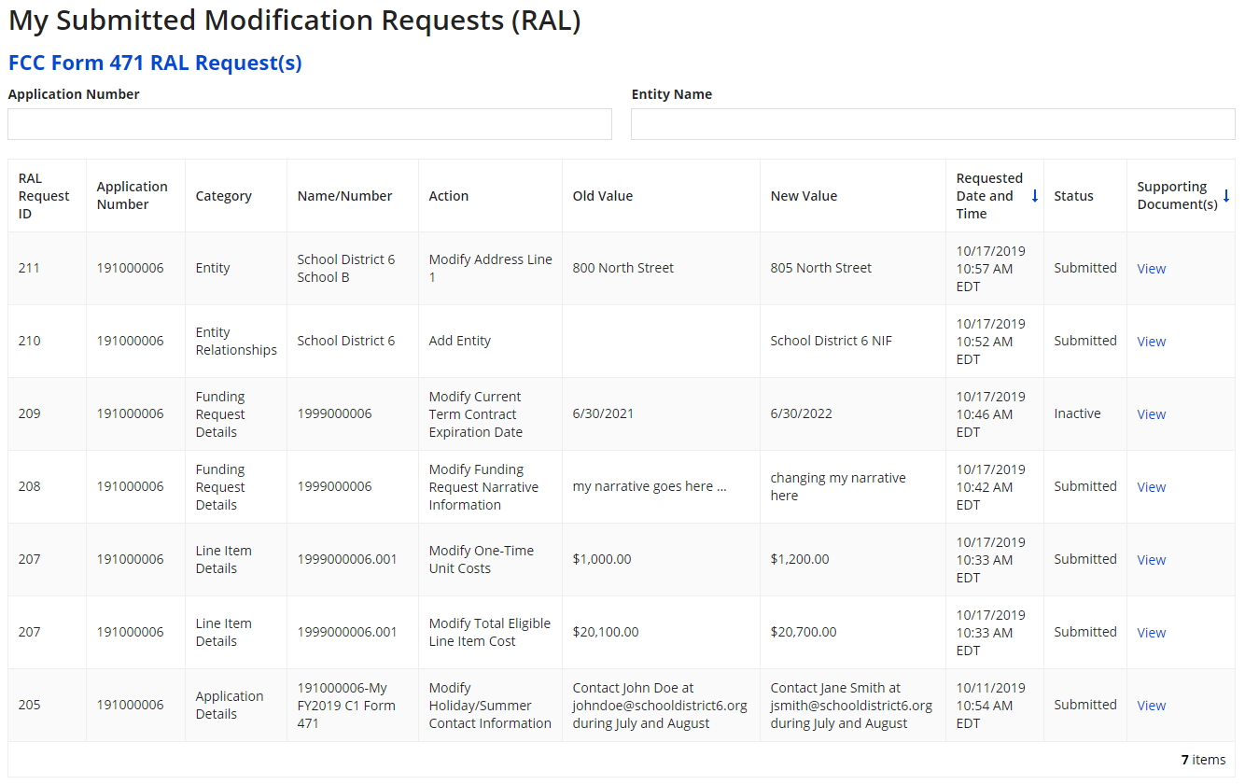
Viewing Modifications
A table with submitted modification requests displays

