Slide 1
Update Form 498

Slide 2
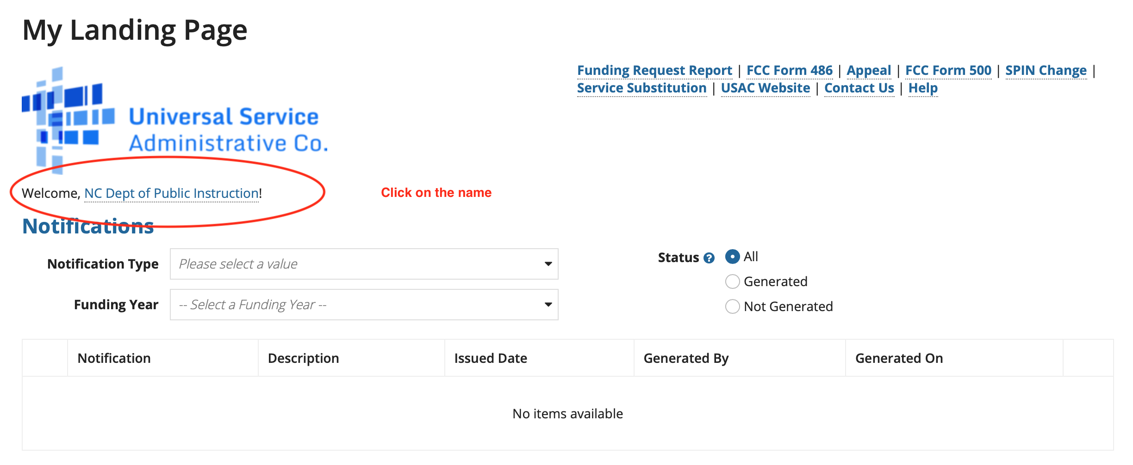
Form 498 Update

Slide 3
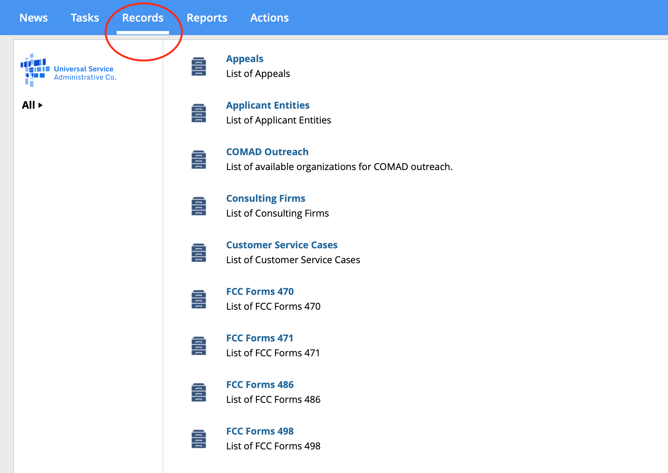
Update Form 498
Click on “Records”

Slide 4
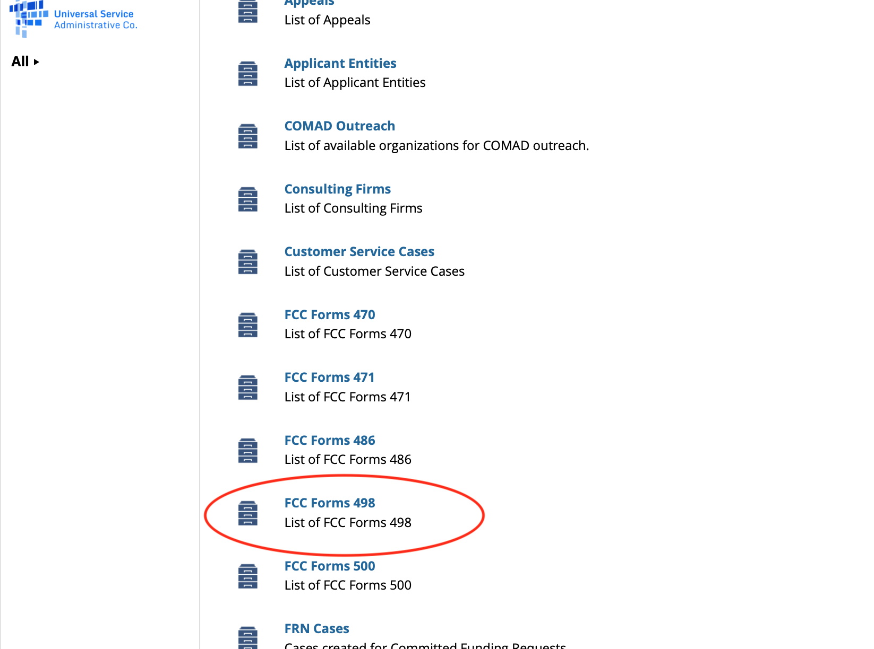
Update Form 498
Click on FCC Form 498

Slide 5
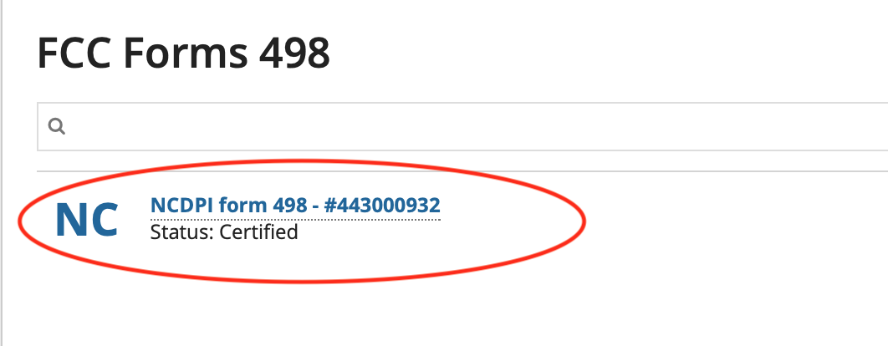
Update Form 498
Click on the link to your Form 498

Slide 6
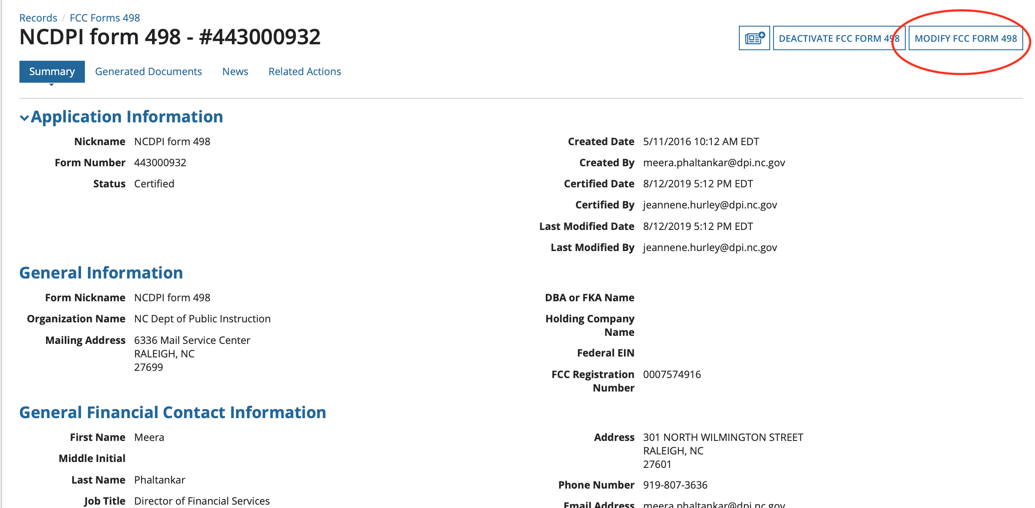
Update Form 498
Click “modify”

Slide 7
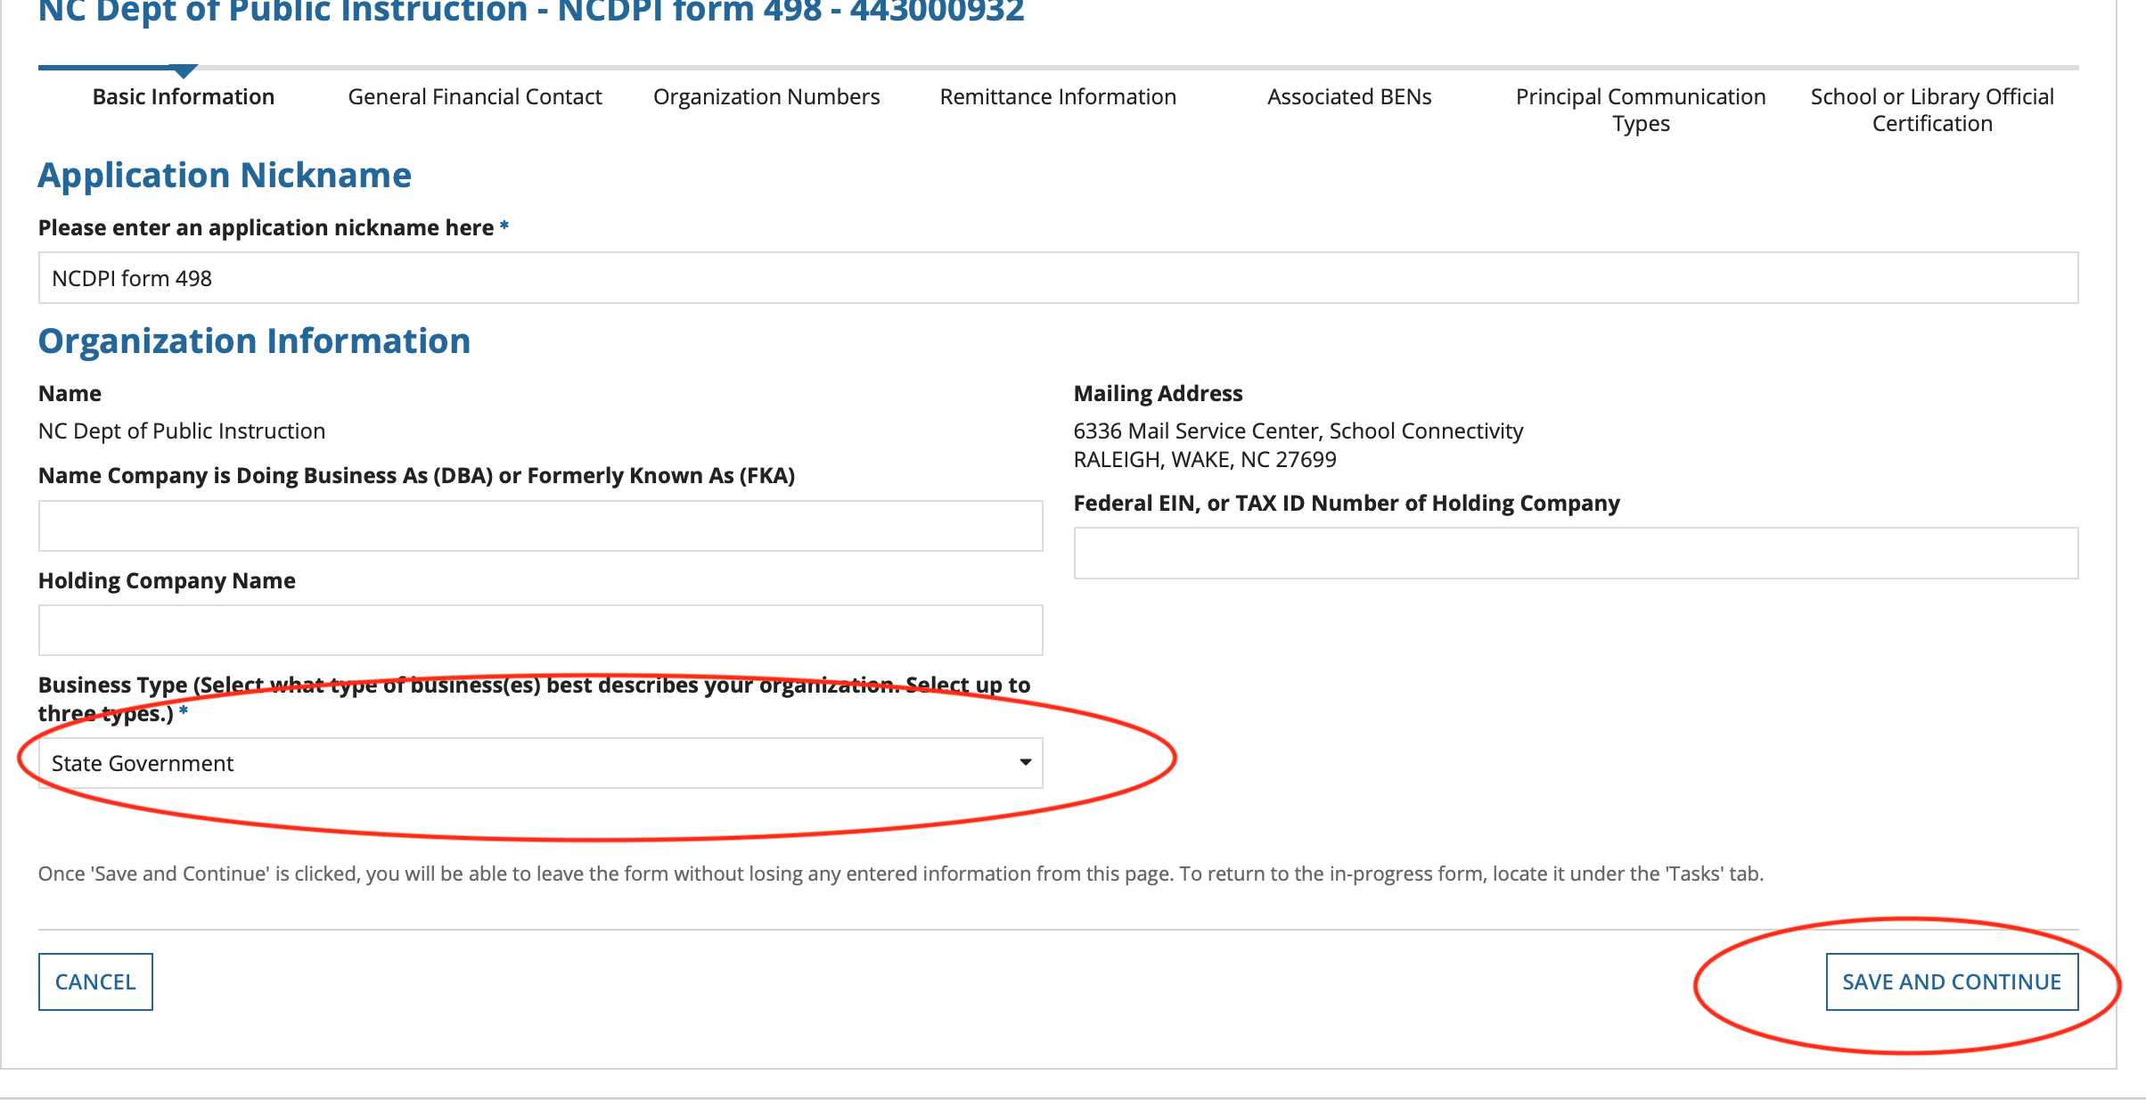
Update Form 498
In the drop down for “Business type”, choose the correct type and then click save and continue.

Slide 8
Update Form 498
School Districts (LEAs) choose Independent School District
Charter Schools choose “non profit”

Slide 9
Update Form 498
Click "continue" all the way through the pages and submit.

