Slide 1
Creating a 471 for 2019-20 NCDPI WIFI C2 Contracts
Step-by-Step for Creating a C2 app
in the EPC portal

Slide 2
Application Nickname
XXX County School District C2

Slide 3
Contact info – Save & Continue
Your name and contact info shows here

Slide 4
Category of Service

Slide 5
Save & Continue…

Slide 6
Save & Continue …

Slide 7
Save & Continue …

Slide 8
Add FRN

Slide 9
NCDPI request….
For switches and Aps, please add the following to your “nickname”:
Name of school, quantity of item and #Item.
ABC High School, 33 #SWITCHES
Or
XYZ Elementary School, 133 #APs

Slide 10
Choose Contract

Slide 11
NCDPI BEN 231411 - search

Slide 12
Start and Expiration Dates
Service Start is 7/1/2019
NCDPI has extended the contracts for one year; new expiration date is 12/31/2020

Slide 13
Short narrative

Slide 14
Where is “Bulk Upload?”
Click the Blue Hyperlink – not the check box!

Slide 15
Bulk Upload!

Slide 16
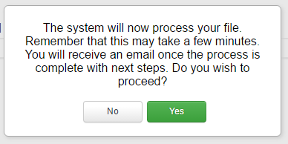
Select Template File
Click “Bulk Upload”
Then choose the Template file you saved, then “Submit,” then “Yes, you want to proceed”

Slide 17
Obtaining Bulk Upload Results
After submitting uploaded Template for review, system will return to EPC
After 30 seconds (about the time it takes to sing the Jeopardy song), you will receive an e-mail notification with a link to the Bulk Upload Results
A “Task” also will appear in your Task Page
Task also will be showing on Landing Page under My Tasks

Slide 18
Success?
If your page looks like this, you’re Bulk Upload was successful! Click Submit!

Slide 19
Unsuccessful?
If your template does NOT upload, either you made changes after “saving” your validated Template, or you are using an incorrect version of the template
Go back to the template and make changes, or
Use a different version of the template. Then…
Start Bulk Upload process over

Slide 20
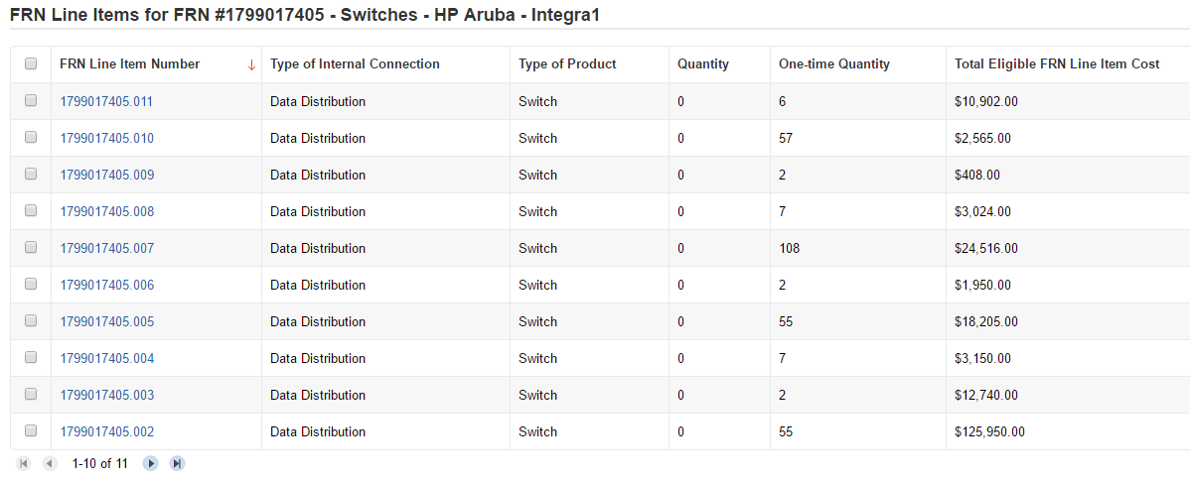
Be Sure to Review Data
It’s important to ensure all uploaded data is showing and is accurate
If data is inaccurate, you can make changes directly on the 471, delete individual FRN Line Items or the entire FRN and start over

Slide 21
Tips for Success
Make sure that you are using the correct version of the template
If you run the process multiple times for a single FRN, each upload will create new FRN line items, regardless of data that has previously been uploaded
Meaning, it won’t “override” the original data
Once the upload is successful, you will be able to make any additional edits within your FCC Form 471
Please ensure that after your final, clean validation, you save the file immediately before clicking in or editing cells throughout the spreadsheet, or else you must click the "Validate Button" again before saving

Slide 22
Questions?
Northeast, North Central, State App
jeannene.hurley@dpi.nc, 252-624-9878
Piedmont-Triad, Sandhills, Southeast
rebecca.martin@dpi.nc.gov, 303-304-4261
Northwest, Southwest, Western
roxie.miller@dpi.nc.gov, 980-285-3551

