Slide 1
April 2018 Sandhills CTO Meeting
E-Rate Update
Jeannene Hurley 252-624-9878
Rebecca Martin 303-304-4261
Roxie Miller 980-285-3551
Mike Ramsey 828-278-9770

Slide 2
2018 Reminder EPC, PIA and PQA
Answer all questions in EPC as quickly as possible
Contact your Regional E-rate Specialist for issues:
With your PIA or PQA reviewer
Submitting responses in EPC
Adding your CFO in the portal, filing 498 or uploading bank verification

Slide 3
New FCDL Format !
https://www.usac.org/sl/about/outreach/videos/Funding-Commitment-Decision-Letters.aspx
WATCH THE VIDEO

Slide 4
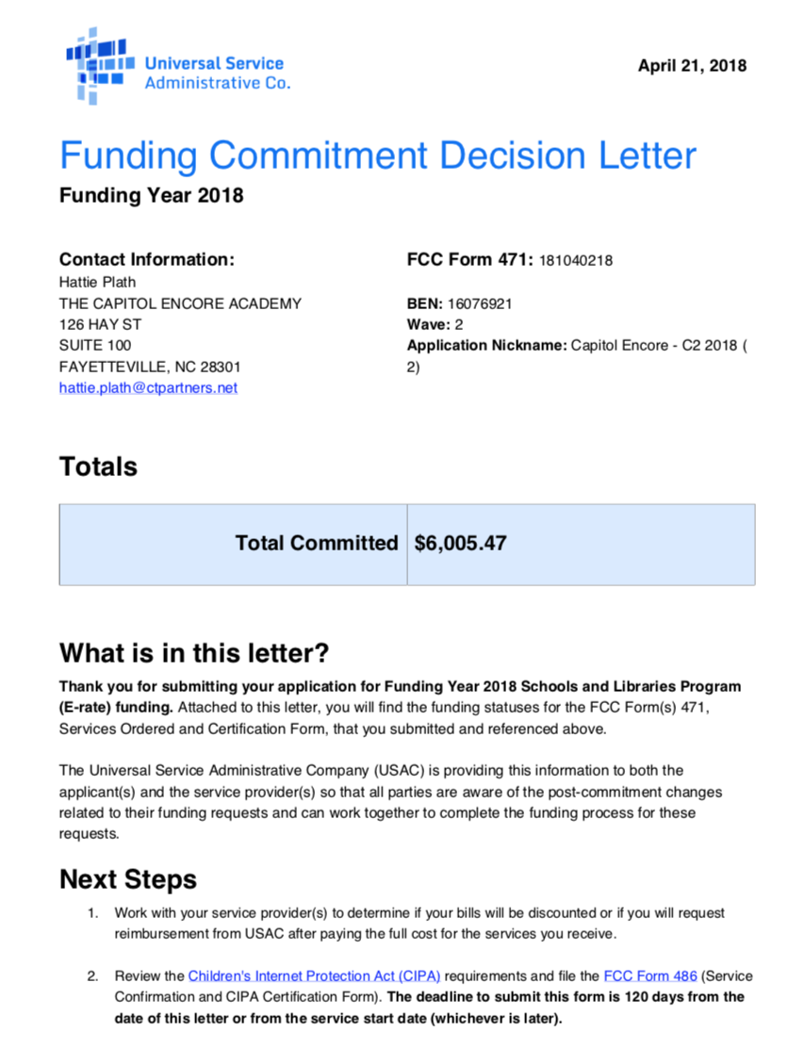
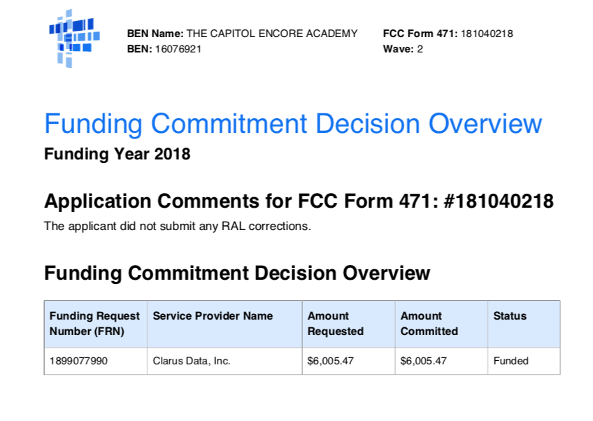
New FCDL Letter

Slide 5
Filing Form 486
Before Filing Form 486 – print FCDL Letter and XLS spreadsheet
File Form 486 keeping service start date 7/1/18
You may select “Early Filing Box” but DO NOT CHECK THE CIPA WAIVER BOX!
Be sure to check the first radio button indicating CIPA compliance

Slide 6
Category 2 Form 486
Category 2 applications are being funded faster than ever this year but we are advising applicants to:
DELAY FILING FORM 486 for Category 2 FRN’s.
Why??

Slide 7
FILING 486 for C2
”Service Start Date” (SSD) clarification from USAC needed
If there is a “mismatch” of SSD between Form 471 and Form 486, it could cause the Form 486 to be thrown into “manual review”. It could also be an issue with invoicing for the vendors

Slide 8
Form 486 for C2
We will update as soon as we receive clarification from USAC on this issue
Thank you for continued patience
as we navigate the E-rate waters

Slide 9
C2 Funding
NCDPI is COMMITTED to funding the non-discounted amount, we cannot guarantee, as of today, that the PRC money for the non-discount will come BEFORE July 1.
We are still in Fiscal Year 2017-18, and we may have to wait until Fiscal Year 2018-19. PLEASE STAY TUNED FOR MORE ON THIS.

Slide 10
GET READY FOR BOOTCAMP!
“Bootcamp at the Beach” July 18, 19, 20(Wed-Fri)
Calabash Fire Department Meeting Room
Calabash, NC
Breakout sessions for those ”New to E-rate”
Space limited to 35 participants so register early
See handout for lodging options

Slide 11
GET READY FOR BOOTCAMP!
Other Regional Bootcamp Announcements and Dates/ Locations Coming Soon
MCNC Offices in RTP/Durham NC
Western NC location to be announced

Slide 12
Questions?
Contact information
Northeast Region, North Central,
Jeannene Hurley, jeannene.hurley@dpi.nc.gov
Southeast, Sandhills, Piedmont Triad
Rebecca Martin, rebecca.martin@dpi.nc.gov
Southwest, Northwest, Western
Roxie Miller, roxie.miller@dpi.nc.gov

