Slide 1
2018 Form 471
Step-by-Step for Filing the Form 471 Using ITS as the Billed Entity
ATT Long Distance

Slide 2
Your Form 470
Remember, you must file your own 470 for local, long distance, or cellular service. After 28 days, evaluate any bids, and if the ITS is the most cost effective, type your Memo to File, memorializing your choice.

Slide 3
Sample Memo to File
MEMORANDUM
To: File
From: School District/Library
Date: 03/08/2018
Subject: Bid Responses for E-Rate Form 470 Application Number 1600xxxxx
___________________________________________________________________
As of today, March 8, 2018, xxx district did not receive any legitimate competitive bids to the local Centrex and long distance telephone services requested on Form 470 Application Number 1600xxxxx. The district chooses to continue to receive these services from its incumbent providers AT&T and CenturyLink.
Also, after careful review of recent invoices from our existing providers AT&T and CenturyLink, the district has concluded that they provide the lowest reasonable price value that the district can obtain for these services and is therefore cost-effective.

Slide 4
Create a Contract Record
From your own applicant portal
Create the “record” for reference in your 471
Be sure to keep your Memo to File for documentation purposes

Slide 5
Where is the contracts module?
The Contracts Module is a section within your organization’s EPC profile.

Slide 6
Manage Contracts
Click on the “Contracts” link in the menu of items across the center of the organization’s page. Then choose MANAGE CONTRACTS

Slide 7
Add New Contract
Click on the “Add a New Contract” button

Slide 8
Contract nickname & number
Provide a Nickname for the contract that will serve as a reminder.
AT&T LD, 2018-19
Contract number for AT&T LD is: ITS-004729

Slide 9
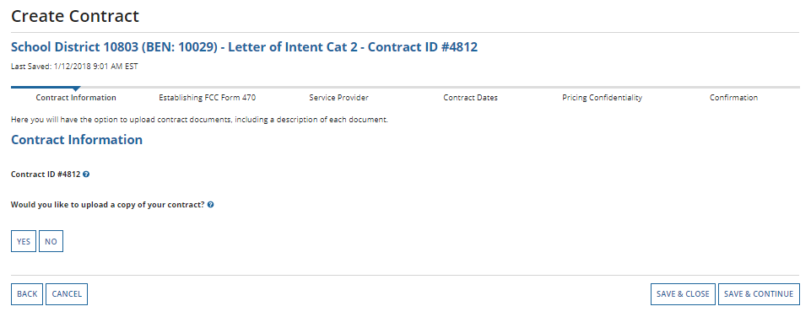
Upload Memo to File as Contract
A number is assigned by the system
Click Yes

Slide 10
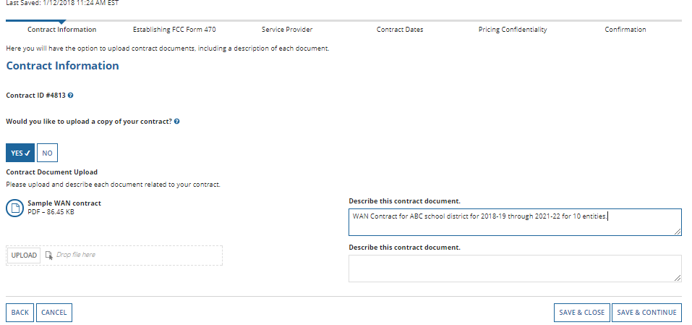
Upload your “Memo to File” document.
Be sure to add a description: This is the Memorialization Document to use the NCDIT SMC for Voice Services
Click on the “Save & Continue” button to proceed

Slide 11
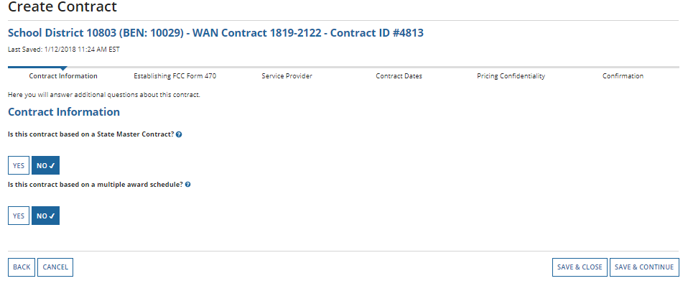
Yes to both – these are contrats that NC Deptartment of Information Technology has negotiated.
Click SAVE & CONTINUE

Slide 12
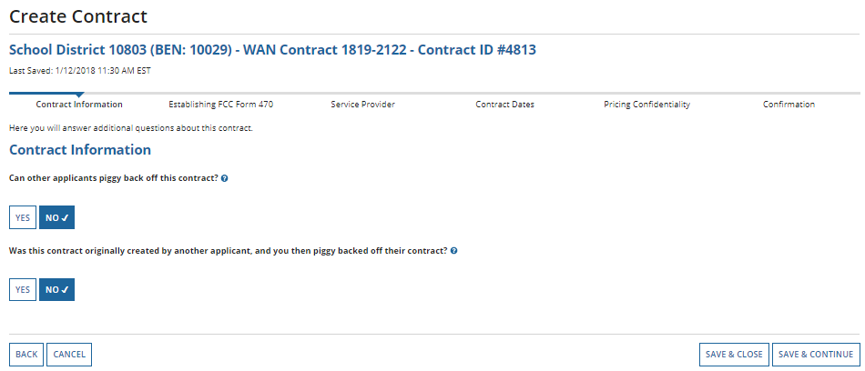
Yes to both of – again, you are using the pricing that DIT has negotiated on behalf of all NC entities.
Save and continue.

Slide 13
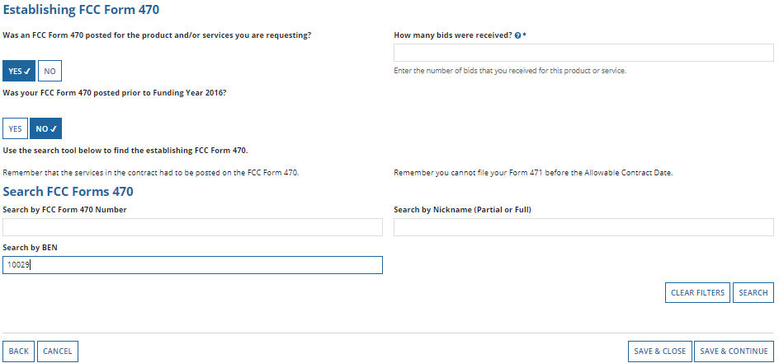
Establishing 470 and Bids Received
Enter the # bids received
Find your 470#

Slide 14
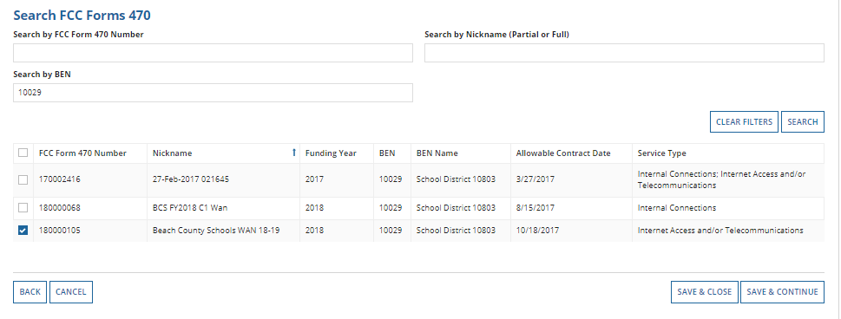
Search out your 470
Check the correct 470, Save & Continue

Slide 15
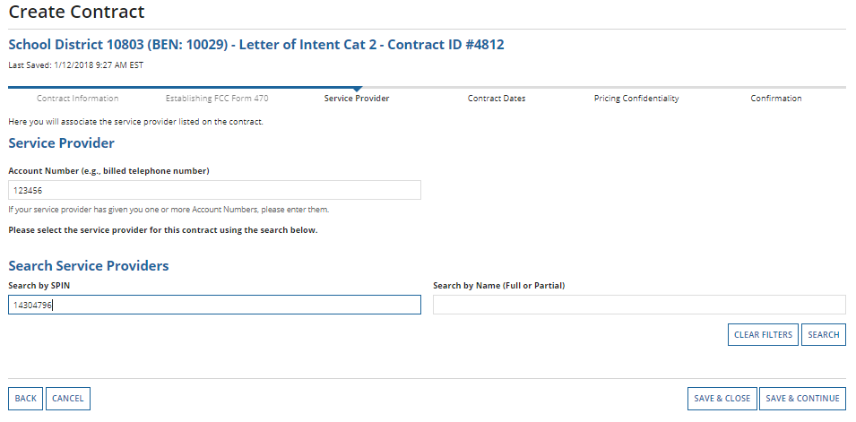
Account Number is usually the main phone number.
Search for the AT&T SPIN which is 143001192

Slide 16
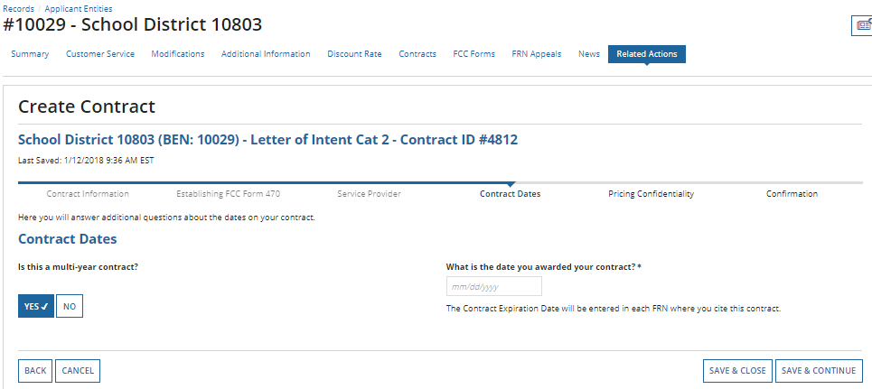
CHOOSE
. Use the date you entered on your Memo to File.

Slide 17
Voluntary Extensions?

Slide 18
Pricing Confidentiality

Slide 19
Review your work
When all fields are correct, choose Complete
Remember: You cannot edit or delete any contracts once you click Complete

Slide 20
Log out of your portal…
Then log in to the DIT portal w your DIT credentials.
Remember: You are now in the State of North Carolina Department of Information Technology portal
You will have Full Rights to the 471 only
DO NOT CLICK SAVE & SHARE!

Slide 21
portal.usac.org
Log in with your DIT credentials
Remember, you will need an entirely new set of login credentials as you are now entering the DIT portal, not your own

Slide 22
DIT Landing Page
Please remember, you are now in the North Carolina Department of Information Technology portal!

Slide 23
Create your 471!
Remember, we are creating several FRNs under this one Form 471. We begin w ATT Long Distance

Slide 24
Application Nickname
Please type the name of your school district or library, along with the services

Slide 25
Contact info

Slide 26
Category 1

Slide 27
Type your BEN
You are the only member on this application!

Slide 28
Select your district/library

Slide 29
Choose Entity Type…

Slide 30
Save and continue

Slide 31
Add FRN

Slide 32
FRN Key Info
Ignore this Copy FRN button!

Slide 33
Contract

Slide 34
Enter your own BEN!
Find your contract record for the AT&T Long Distance

Slide 35
Select the record, continue

Slide 36
Contract Expiration Date
This contract expires 12/31/2020

Slide 37
Narrative

Slide 38
FRN Line Item
Click the blue hyperlink…

Slide 39
Add New FRN Line Item

Slide 40
Long Distance Only

Slide 41
Continue…

Slide 42
Enter the highest monthly amount from the past year (Sept or Oct)
Be sure to enter zeros in the “one-time” cost section

Slide 43
Recipients of Service
Search for your district and once the name displays, click the “Add All Dependent Schools and NIFs.

Slide 44
Add all dependent schools and NIFs

Slide 45
If necessary, check entity for removal…

Slide 46
Save and continue

Slide 47
Review Recipients - Continue

Slide 48
Add Next FRN
You are now ready to add your next FRN for service
BellSouth Local
Frontier Local
Centurylink Local
Cellular

