Slide 1
Completing Connectivity Questions
Complete this task BEFORE beginning a Form 471.

Slide 2
The Basics

Slide 3
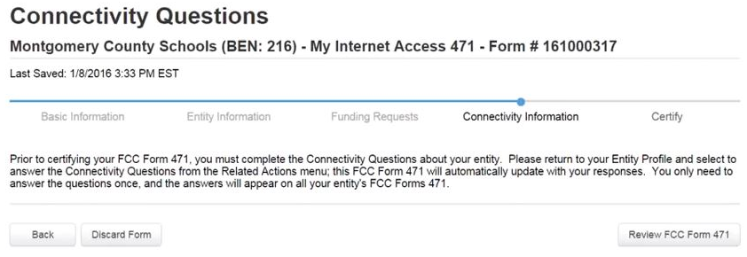
Do I have to answer the questions?
Yes!
During the creation of a Form 471, you will be informed that Connectivity Questions must be answered prior to the form being certified.

Slide 4
When do I answer the questions?
You can leave the Form 471 to answer the questions prior to certifying the form, but it is much easier to complete this step first before beginning the form.
You only have to answer the questions one time, regardless of the number of forms that you will be filing.
School districts will answer questions both at the district-level and for each individual building within the district.
Each Form 471 that you file will be populated with the answers you provide.

Slide 5
Where are the questions?
The Connectivity Questions are located in a section within your organization’s EPC profile.

Slide 6
School Districts: Completing the Questions

Slide 7
LEAs
① On your organization’s Landing Page, click on the link for the school district

Slide 8
LEAs
② Click on the “Related Actions” link in the menu of items at the top of the organization’s page

Slide 9
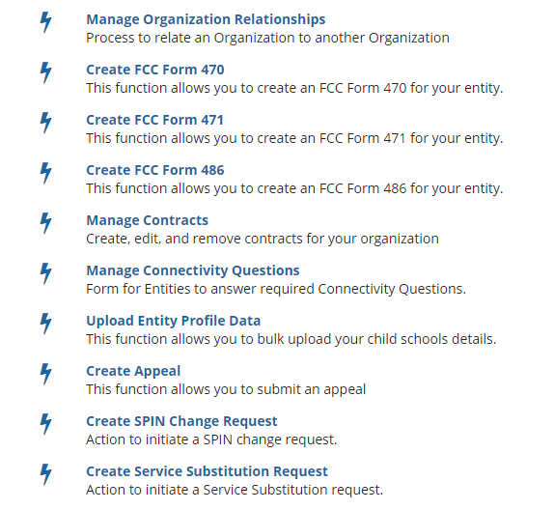
LEAs
③ Scroll down and Click on the “Manage Connectivity Questions” link to proceed

Slide 10
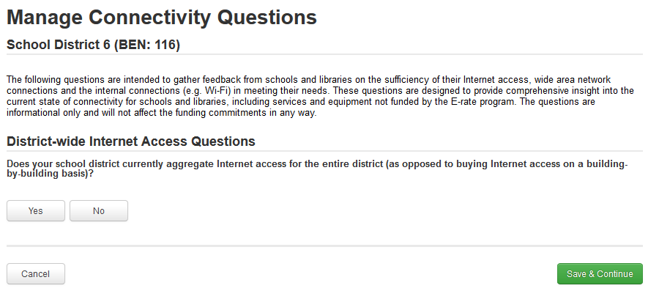
LEAs
④ Determine if the district aggregates Internet Access across the entire district
B
If it does not aggregate, click on the “No” button
A
If it does aggregate, click on the “Yes” button
NOTE: If you are a member of NCREN and filing as a district, you can safely select “Yes”

Slide 11
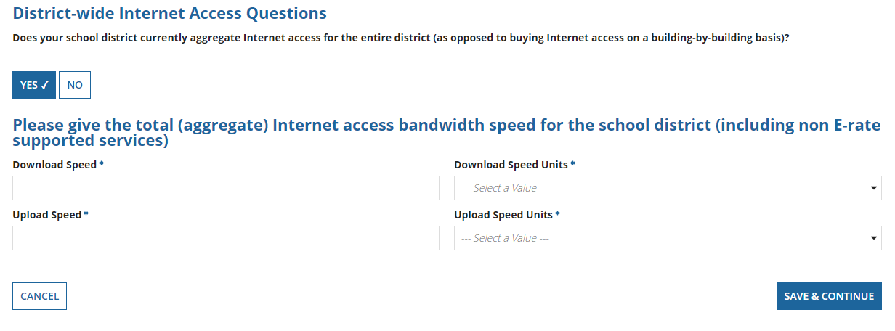
LEAs
① If you selected “Yes”, enter values
for download and upload speed and units
A

Slide 12
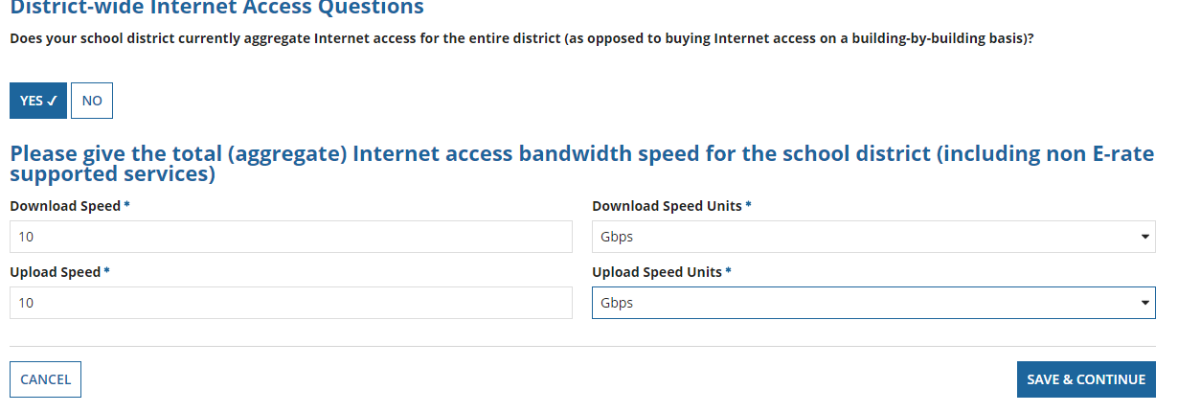
LEAs
1
1
② Click on the “Save & Continue” button to proceed
A

Slide 13
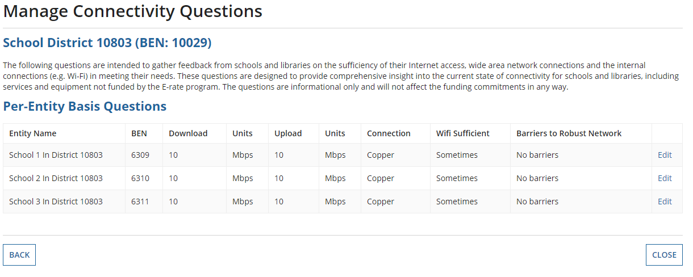
Connectivity Questions must also be separately answered for each school in the district
LEAs
⑤ Click on the “Edit” button for a school to answer the questions for that school

Slide 14
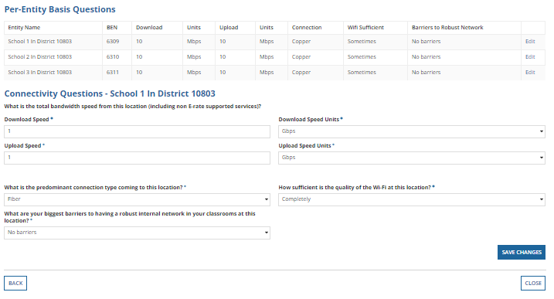
LEAs
Scroll Down.
Connectivity Questions for the selected school will appear below the table that lists schools in the district.

Slide 15
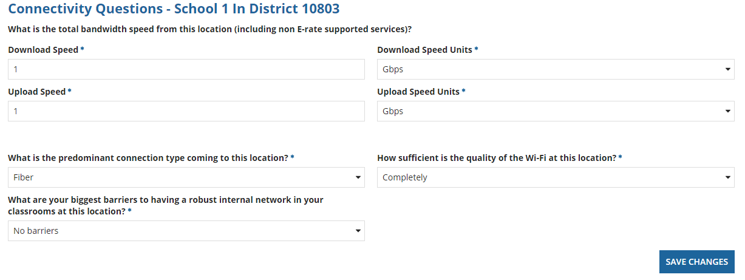
LEAs
⑥ Answer the to the best of your knowledge for as things exist today, not as they will after any FY2018 E-Rate requests
⑦ Then click on the “Save Changes” button

Slide 16
LEAs
⑧ Repeat the process for each school by clicking on the “Edit” button to answer the questions for that school

Slide 17
LEAs
⑨ Click on the “Close” button when you have answered the questions for each school in your district

Slide 18
Charter Schools: Completing the Questions

Slide 19
Charters
① On your organization’s Landing Page, click on the link for the school

Slide 20
Charters
② Click on the “Related Actions” link on the menu of items at the top of the organization’s page

Slide 21
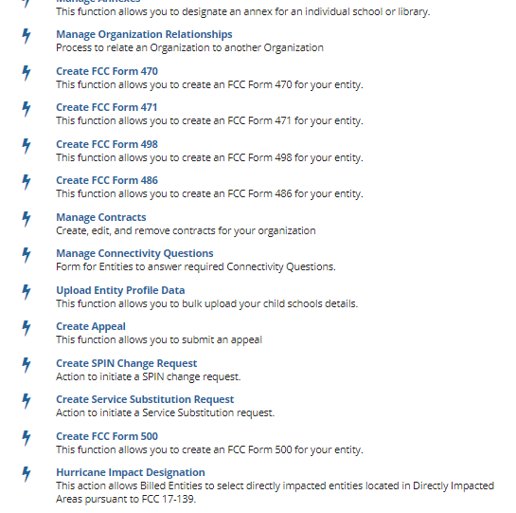
Charters
Scroll down and Click on the “Manage Connectivity Questions” link to proceed

Slide 22
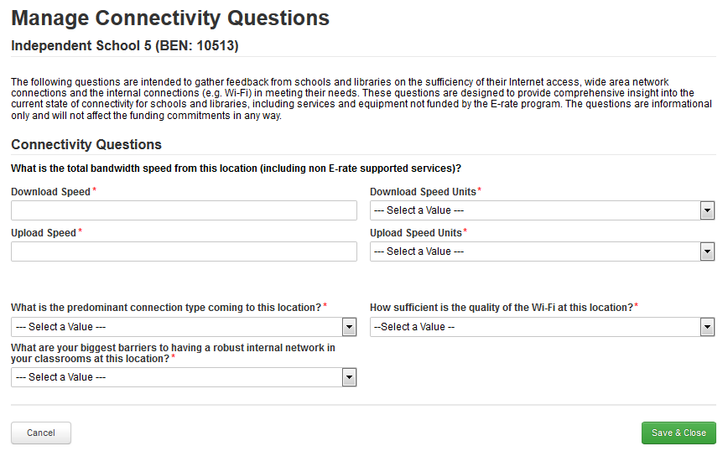
Charters
④ Answer the questions to the best of your knowledge for as things exist today, not as they will after any FY2016 E-Rate requests

Slide 23
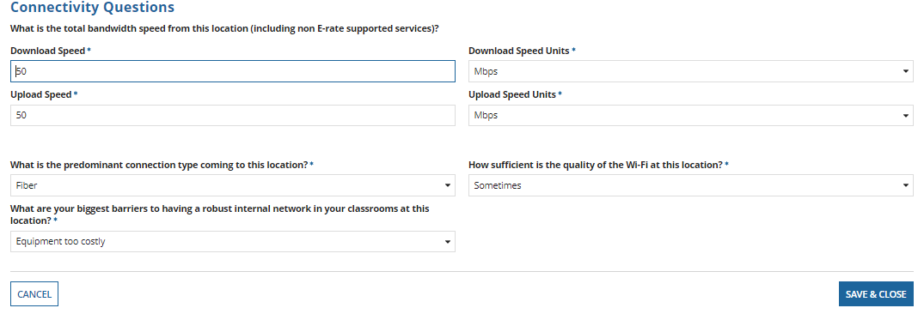
Charters
Most charters are 10, 20 or 50 Mbps
⑤ Then click on the “Save & Close” button

