Slide 1
Creating a Contract for Category 1
Step-by-Step for Uploading in the EPC portal

Slide 2
Complete this task BEFORE beginning a Form 471 if you are requesting funding for a contracted service.

Slide 3
The Basics

Slide 4
Do I have to use the contracts module?
During the creation of a Form 471, you will indicate for each FRN how you will be purchasing the requested services:
Contract
Yes: If you indicate that the FRN is for contracted services, you will be prompted during the process to refer back to a contract that is listed in the contracts module
Month-to-Month
No: The contracts module is not required for that FRN
A tariffed service is a telecommunications service that you purchase at rates
regulated by the state regulatory commission and/or the FCC, for which you do not have a signed, written contract.
Tariff
No: The contracts module is not required for that FRN

Slide 5
When do I use the contracts module?
You can enter your Letter of Intent in the contracts module during the creation of your FRN, but it is much easier to enter the information in the module first so you do not have to leave the Form 471 mid-process.

Slide 6
Where is the contracts module?
The Contracts Module is a section within your organization’s EPC profile.

Slide 7
The Contracts Module

Slide 8
Click on the “Contracts” link in the menu of items across the center of the organization’s page. Then choose MANAGE CONTRACTS

Slide 9
Click on the “Add a New Contract” button

Slide 10
Contract Information

Slide 11
Provide a Nickname for the contract that will serve as a reminder. Type the Contract number, can use billing acct. number if you don’t have one.

Slide 12
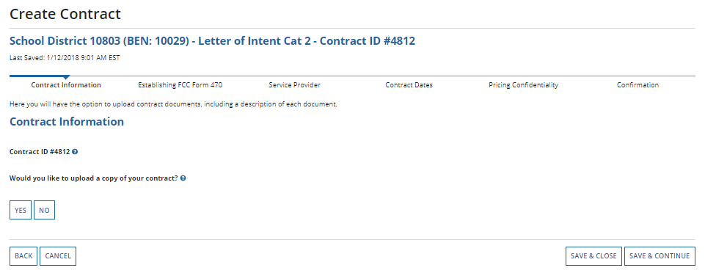
Upload Letter of Intent as Contract
A number is assigned by the system
Click Yes to upload

Slide 13
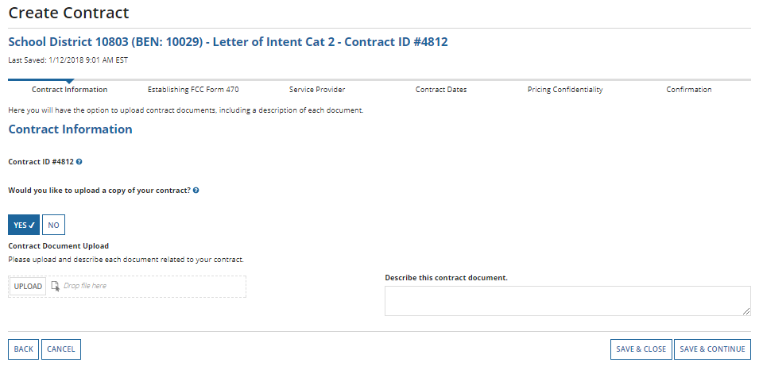
Chose “UPLOAD” button to locate your contract. Give the system a moment to upload once you pick the file. Or DRAG and DROP

Slide 14
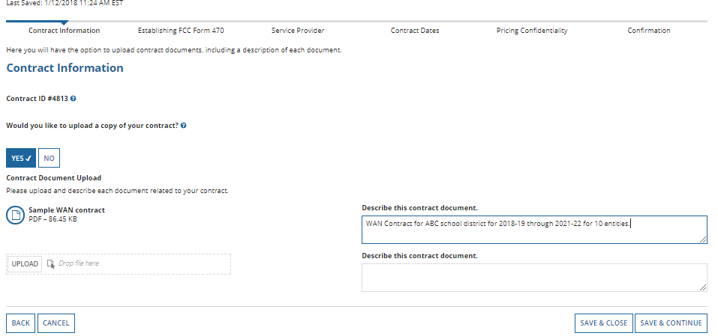
Repeat the process for any additional documents associated with this contract, or any other contracts.
Be sure to add a description
Click on the “Save & Continue” button to proceed

Slide 15
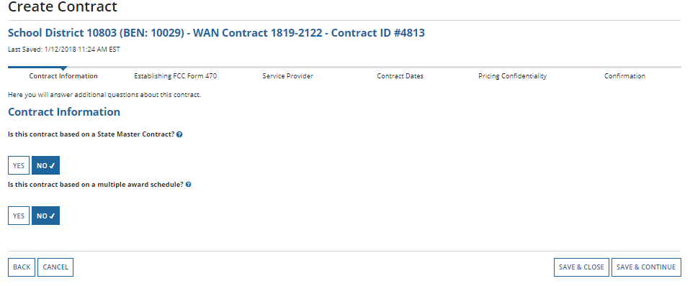
No to both questions for your personal contracts. (typically)
Click SAVE & CONTINUE

Slide 16
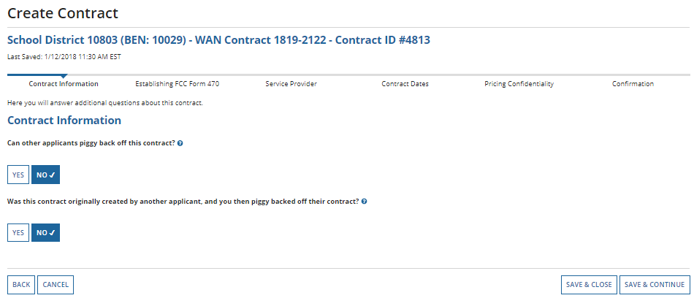
No to both of these unless your contracts were written differently than most.
Save and continue.

Slide 17
Establishing Form 470

Slide 18
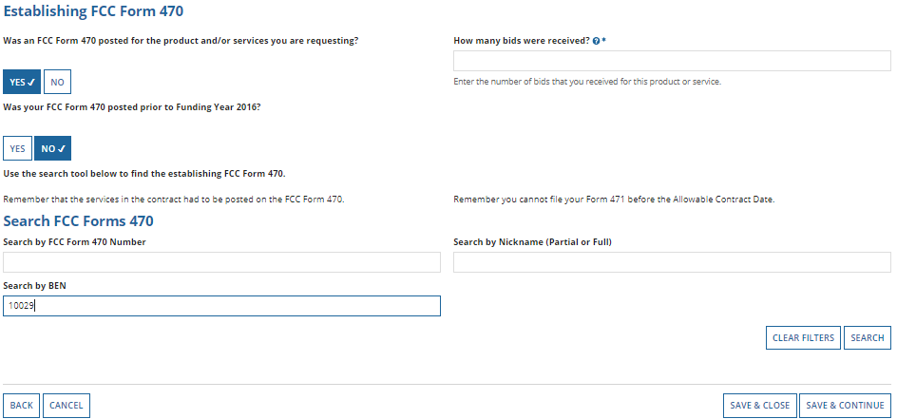
Enter the # bids received
Find your 470#

Slide 19
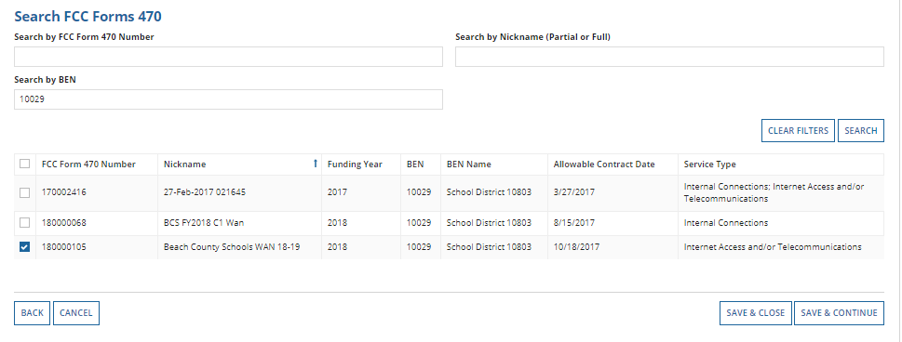
Check the correct 470, Save & Continue

Slide 20
Service Provider

Slide 21
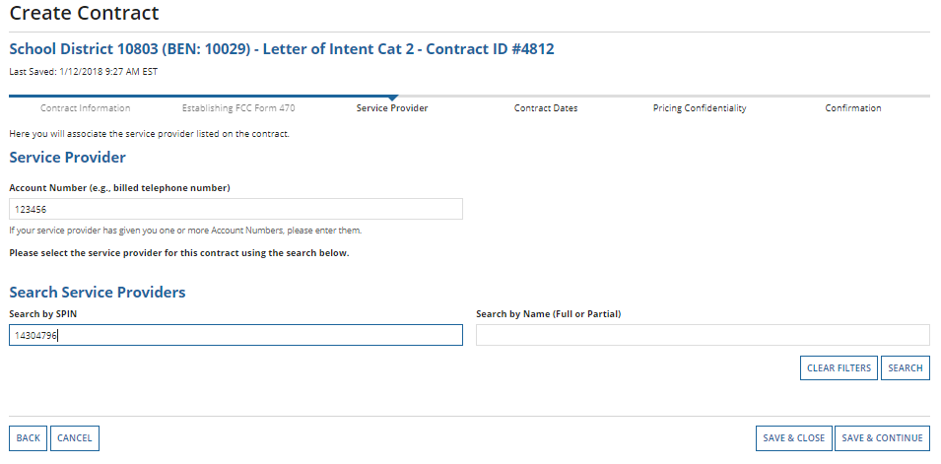
Enter the account number if you have one or make up one, use your phone number.
Enter the SPIN, click Search. When the results are in, click the checkbox in front of the SPIN number and Save & Continue.

Slide 22
Contract Dates

Slide 23
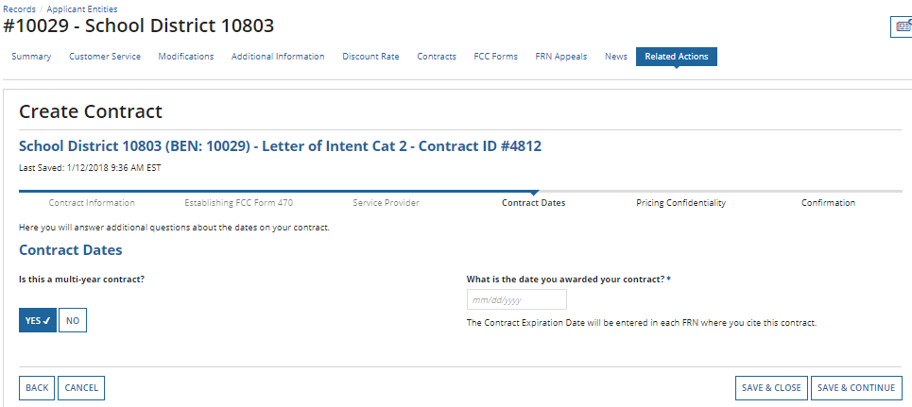
CHOOSE
Words of Caution: Your Contract Award Date is usually the date the BOE approved the contract. – which is certainly After the Allowable Contract Date, and Before filing and certifying the Form 471.

Slide 24
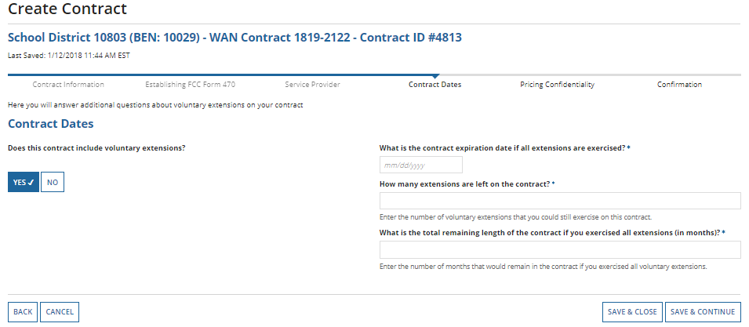
Contract Dates
Complete according to your contract!

Slide 25
Pricing Confidentiality

Slide 26
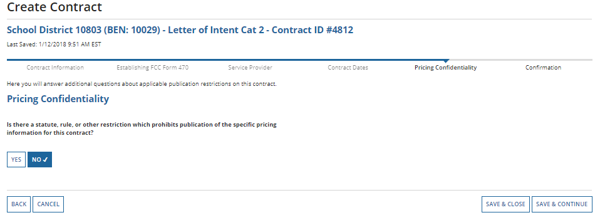
Pricing Confidentiality
Words of Caution: There must be an actual statute in place. It is not sufficient for the vendor to simply state that their pricing is confidential. When in doubt, click on “No”!

Slide 27
Confirmation

Slide 28
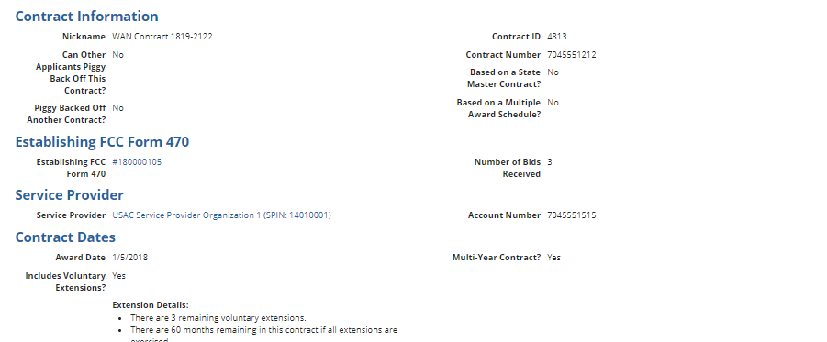
Confirmation
The contract info that has been entered will display

Slide 29
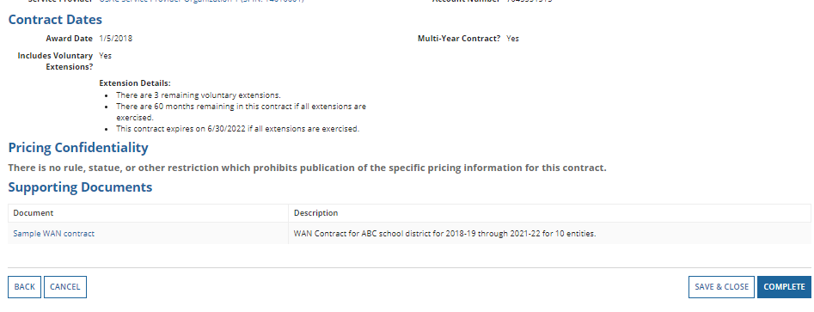
A
To save this contract as a draft so you can continue to edit it, click on the “Save & Close” button
B
To submit the completed contract, click on the “Complete” button

Slide 30
Submitted contracts appear in the Contracts Module list and can be referenced when filing a Form 471

Slide 31
Editing Contracts
You can edit any contract that is still in draft form.

Slide 32
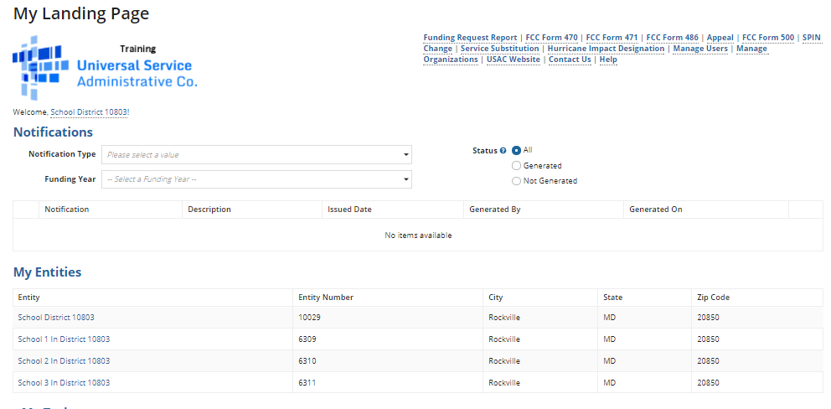
On your organization’s Landing Page, click on the link for the school district or independent school if it is a school not associated with a school district

Slide 33
Click on the “Contracts” link in the menu of items on the top of the organization’s page

Slide 34
Click on the “Manage Contracts” button
NOTE: Only submitted contracts appear on this page

Slide 35
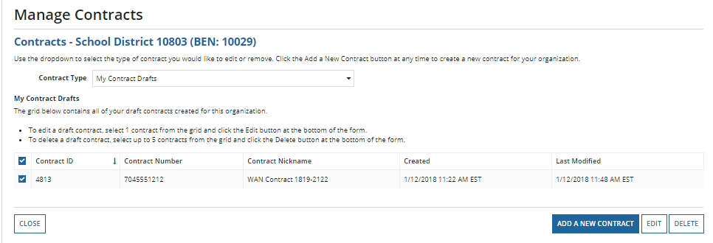
Any contracts you have begun creating but not yet submitted and are still in draft form will appear by default in the list
Select the check box for the contract you wish to edit

Slide 36
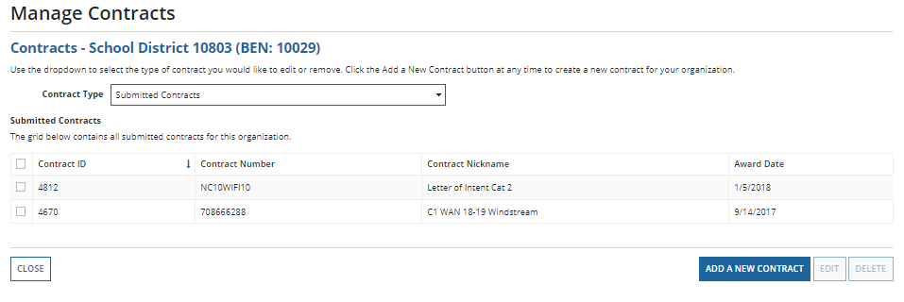
To view submitted contracts on this page, change the “Contact Type” drop down menu to “Submitted Contracts”
You can’t EDIT a submitted contract! Nor DELETE one.

Slide 37
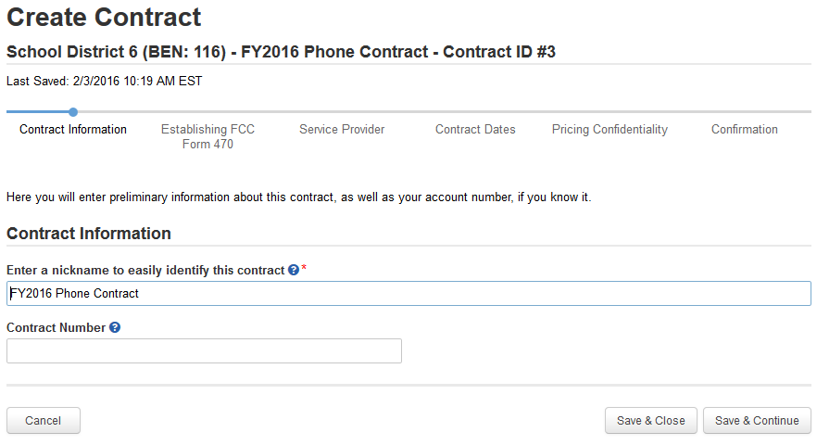
Continue working on the contract creation process or edit the information as necessary

Slide 38
Removing Contracts
You only delete or edit contracts in DRAFT mode.
You cannot recover a contract that has been deleted.

