Slide 1
2018 Filing a Form 471 For C2
Step-by-Step for Creating and Submitting your 471 Application in the EPC Portal

Slide 2
Before you begin the 471
Be sure you have completed the manage connectivity module for ALL buildings.
If you have contracted service(s), be sure you have uploaded all of your contracts BEFORE beginning a Form 471 if you are requesting funding for a contracted service.
If you fail to get your entities updated on time, make sure you include this message in your narrative and then file a RAL correction.

Slide 3
Purpose of Form 471
Filed to request discount on eligible service
Filed annually
Must be based on a previously filed Form 470
470 and/or RFP available for 28 days minimum
ACD is on the Form 470
Must be filed AFTER signing contracts, or AFTER selecting your MTM service provider
Could be based on a prior year 470

Slide 4
When to File
The FCC Form 471 must be filed during a specific application window each year
All materials associated with the FCC Form 471 must be filed by 11:59 PM ET on or before the last day of the FCC Form 471 application filing window in order for the request to be considered as inside the window.
Form 471 Filing window:
Opened – January 11, 2018 ( Noon EST)
Closes – March 22, 2018 (11:59 pm EDT – Postmark Date)
Last date to file a Form 470 – February 22, 2018

Slide 5
Filing FCC Form 471
You must complete and submit the FCC Form 471 by filing the form online in EPC.
You may file more than one FCC Form 471
Note: you MUST file separate applications for Category One (Internet Access, Telecommunications Services, and/or Voice Services) and Category Two (Internal Connections, Managed Internal Broadband Services, and/or Basic Maintenance of Internal Connections).

Slide 6
Prerequisites
Entity Profile
Before you file an FCC Form 471, confirm and update the values in your applicant entity’s profile.
The data in your entity profile is used to calculate your discounts in the EPC system
Connectivity Questions
Must be completed in order to submit the Form 471.
Being part of your organization’s profile, so you only answer them once, regardless of the number of forms you file.
Contracts
Before you begin your application, enter any contracts that you will be associating with Funding Request Numbers (FRNs) in your entity’s profile
This includes contracts awarded in a previous funding year

Slide 7
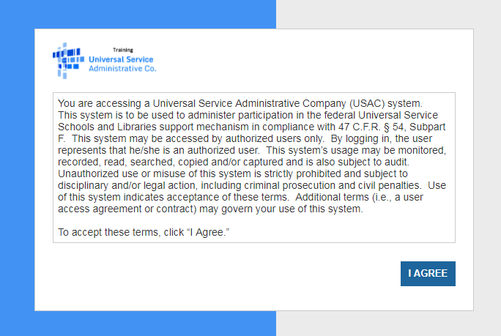
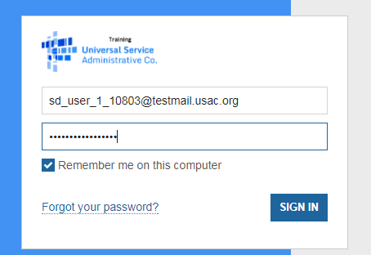
To access the EPC Portal, go to https://portal.usac.org
Click on “I Agree” to accept the terms. Enter your email address as username, and password.

Slide 8
Creating the Form 471 for Category 2 Purchases

Slide 9
Creating the Form 471
From the Landing Page, click on “FCC Form 471”.
Note: When you begin the FCC Form 471, the basic information about your Billed Entity will be automatically populated from your profile. If any of the information displayed is incorrect, update the organization’s profile. Once the information has been updated, it will automatically update in the form as well.

Slide 10
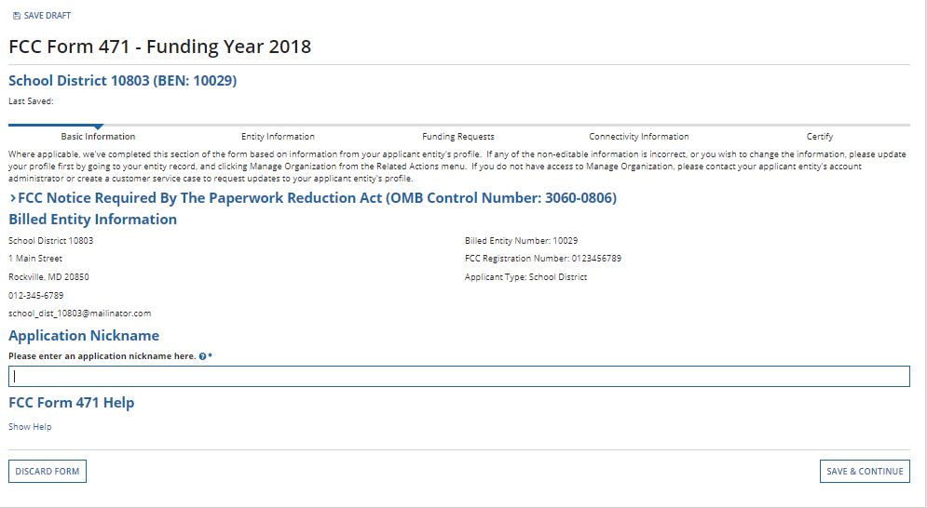
Creating the Form 471
If you click “Save Draft”, the application will display a “Form saved successfully” message. You will remain on the current page until you select another option.
Enter an application nickname, and click on “Save & Continue”.
As before, breadcrumbs are listed at the top, and required fields are indicated by *.
You also have the option to “Discard Form” to discard your work. Once you confirm that you want to discard the form, it will no longer be available in the EPC system.

Slide 11
Creating the Form 471
If, after completing part of the form, you want to save your work and return to it later:
• Click the “Save Draft” link or “Save & Continue” button and then log out of EPC.
• Click the “Task” tab to locate the in-process form when you return to EPC.
Please note: the task is named “Create Form 471” instead of “Continue”. However, you will be taken to the screen in the application where you left off.

Slide 12
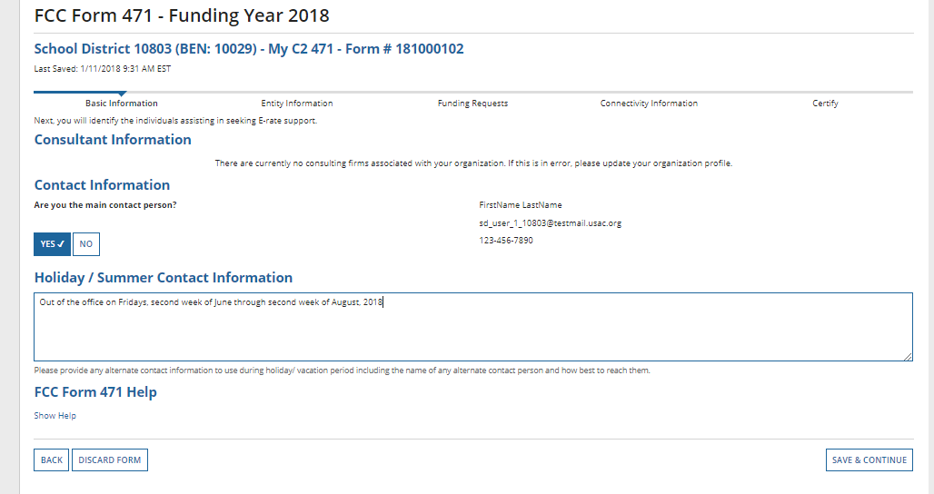
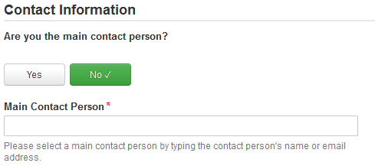
Contact Information
Choose “Yes” if you are the main contact, and your information will be displayed.
Provide “Holiday / Summer” contact information if appropriate, and click on “Save & Continue”
Note: If you are not the main contact, select “No” and search by name or email address. The person must have a portal account to be added.

Slide 13
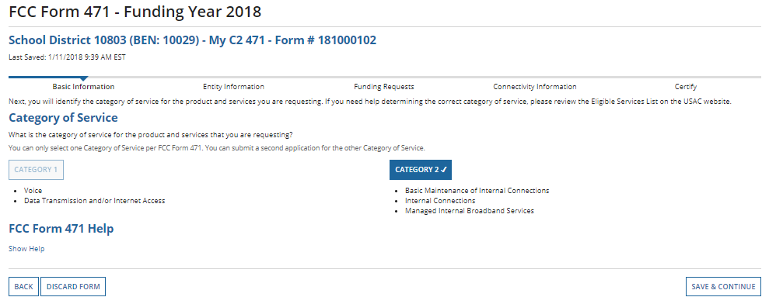
Category of Service
Choose the “Category of Service” for the products/services you are requesting on this Form 471. Once you click, the button will turn BLUE. Save and Continue.
Remember, you must select Category 1 OR Category 2. You cannot have both on the same Form 471. Also, once you click “Save & Continue”, you cannot change the selected category for this application.

Slide 14
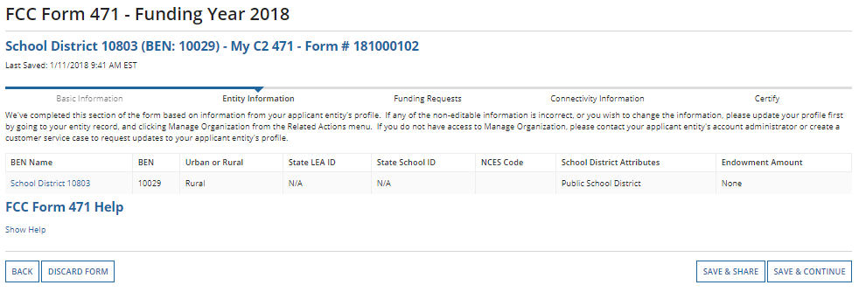
Discount Calculation - Prepopulated
This portion of the form populates, and displays information based on your entity's profile. Click on “Save & Continue”

Slide 15
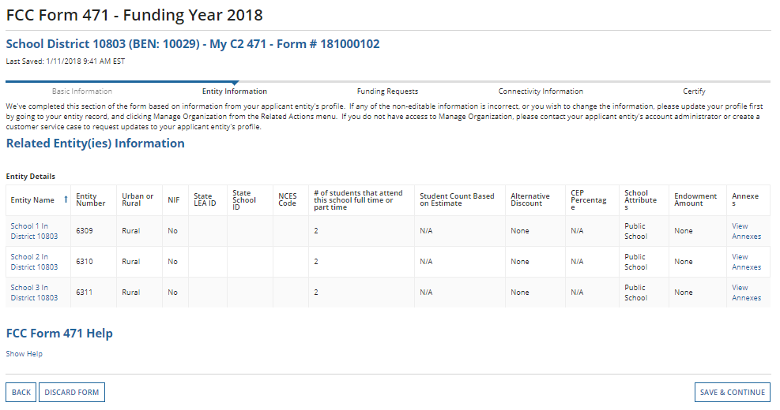
Related Entity Information
View Related Entity Information. Click on “Save & Continue”.
Note: If you need to correct information, click on the entity name to quickly go to their Organization Detail page, and “Manage Organization”. When done, click on “Tasks” at the top, and “Create Form 471” to continue.

Slide 16
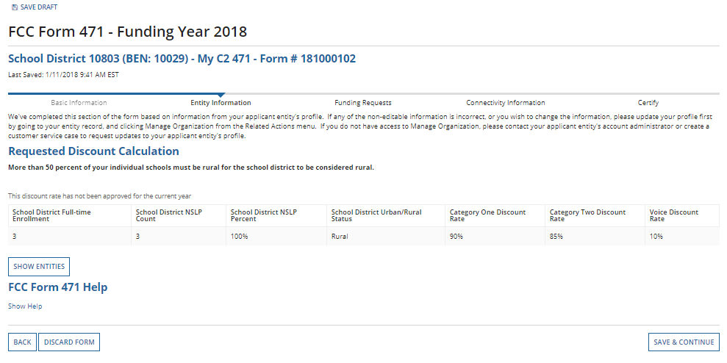
Requested Discount Calculation
Discount Calculation based on your entity's profile.
To see a list of all entities, click on “Show Entities”
Click on “Save & Continue”

Slide 17
Voice Eligibility

Slide 18
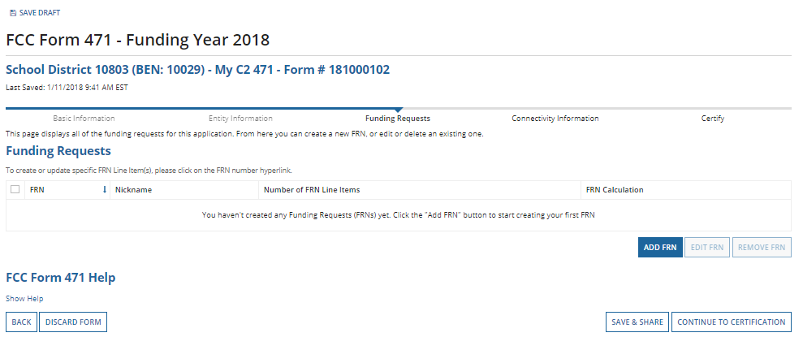
Funding Requests
Click on “Add FRN” to begin.

Slide 19
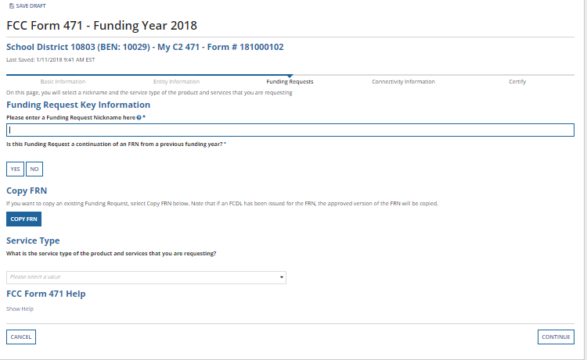
FRN – Nickname and Service Type
Enter a nickname for the FRN.
If this is a continuation of an FRN from a previous year, you can choose “Yes” and enter that FRN from last year.
Optional: Select the “Copy FRN” button to copy FRN information from the CURRENT Funding Year.
Click on the drop down menu to choose the “Service Type” you are requesting, and then click on “Continue”
Basic Maintenance of Internal Connections
Internal Connections
Managed Internal Broadband Services
Notes:
In most instances you will ignore this – but for C2, this could be very helpful.

Slide 20
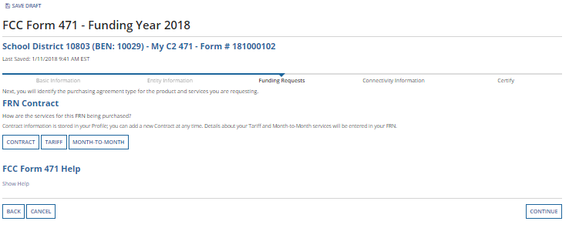
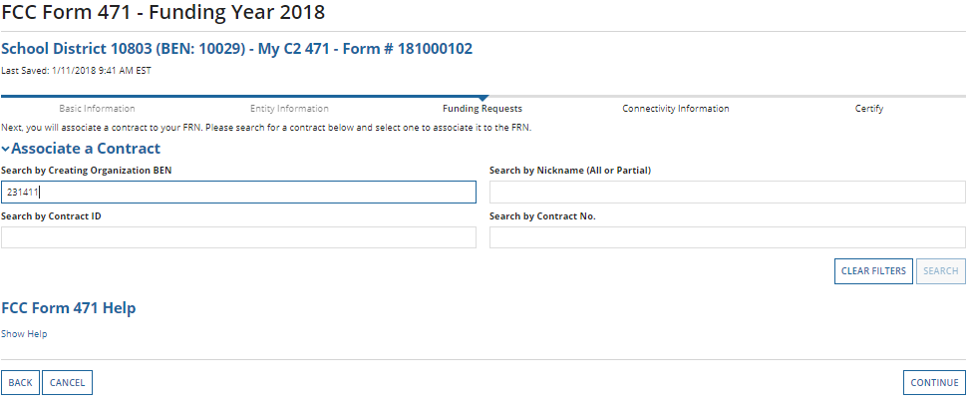
Contract or MTM?
Choose how the services will be purchased, and click on “Continue”.
If “Contract” was indicated, search for the associated contract that was uploaded previously.
Enter search criteria, and click on “Search”. Results will be listed in a grid below. Click box to select contract. The summary will display below.
For DPI contracts, search by our BEN 231411

Slide 21
Choose Your Vendor

Slide 22
Prefilled Data from Contract

Slide 23
Dates
Service Start Date is 07/01/2018
Contract Expiration Date is 03/17/2020
7/1/2018
03/17/2020

Slide 24
Service Narrative
Add a description of your products and services! If entities were updated during Admin Window, do this here! “We will be filing a RAL correction to update entities.

Slide 25
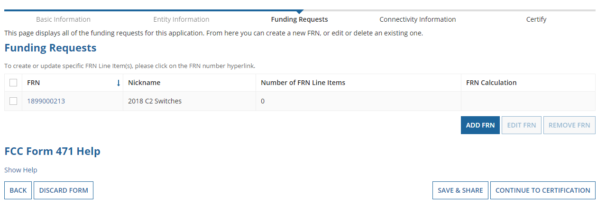
Add a FRN Line Item
PIA must now understand what it is you are specifically requesting.
Click the newly created FRN number which displays as a blue link.
Try to RESIST clicking the very seductive “Add FRN button”
Notes:
Only click the Add FRN button to actually create more FRNs under this application.

Slide 26
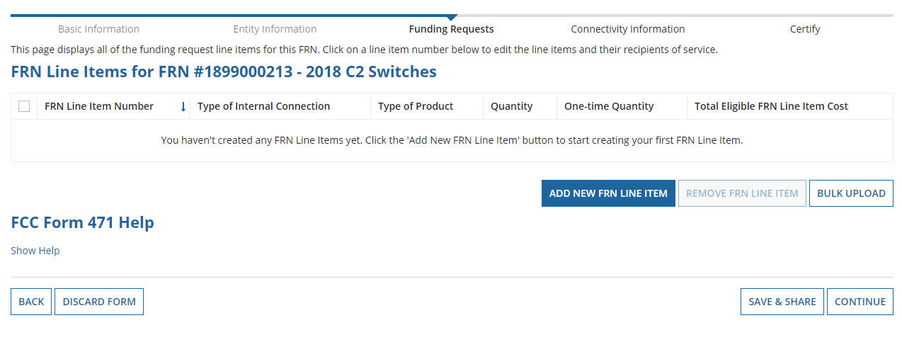
Add a FRN Line Item
Click here to add line items to the FRN
Or
Bulk Upload Item 21 Template

Slide 27
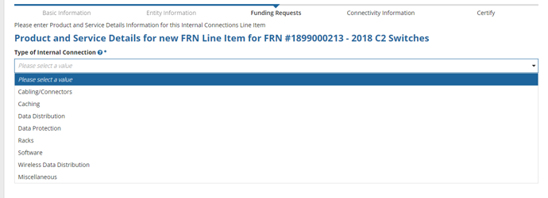
Type of IC
Choose the type of IC for this FRN Line Item.
Slides 27-32 depict hand keying data, not using the Bulk Upload Tool

Slide 28
Choose from drop downs
Key In
Answer

Slide 29
Cost Calculations
All boxes must have an entry!
Click Save & Continue

Slide 30
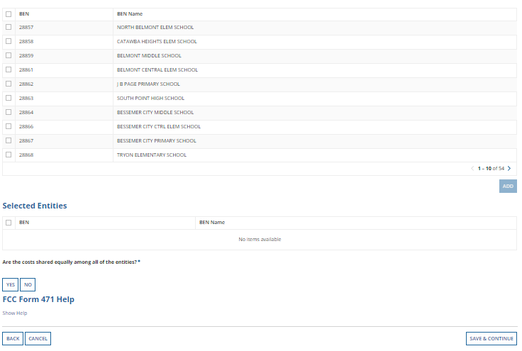
Recipients of Service
Indicate which entities will receive service for this line item. If all entities will, click “Yes”.
If “No”, select from your organization’s list of entities, and click on “Add”.
Note: You can search by Entity Number if you have a large number of entities listed.

Slide 31
Recipients of Service
Click in the box beside the entity and click Remove if you made a mistake.
Are all entities selected getting an equal amount/cost share of equipment? Choose YES. If not, choose No.

Slide 32
Cost allocations
Amount from cost calculation sheet, must be allocated among entities receiving service.

Slide 33
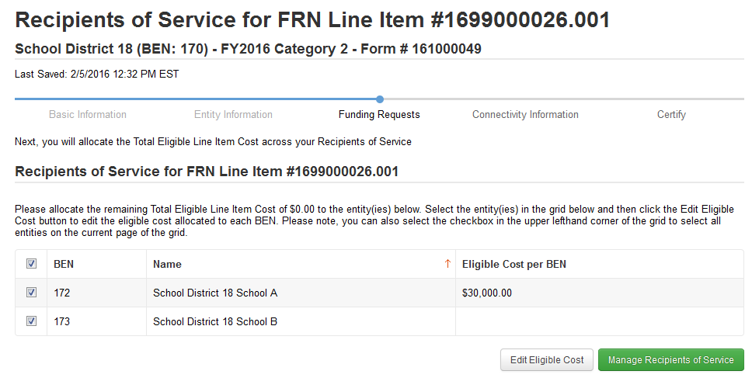
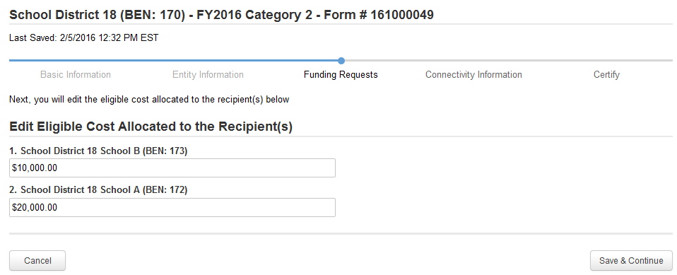
Select the entities in the grid, and click “Edit Eligible Cost”
Enter the cost for each recipient, and click on “Save & Continue.

Slide 34
Did you allocated all of the $$ for the FRN line item?
Make changes here or Continue

Slide 35
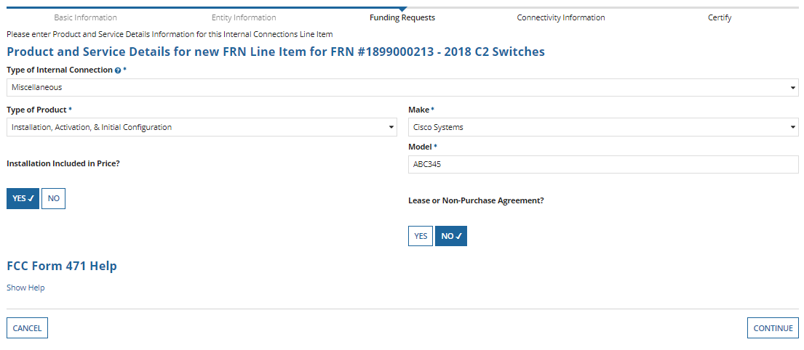
To add additional line items, click “Add New FRN Line Item”.
In this case we are adding the Installation portion of the cost.
Provide information, and click on “Continue”

Slide 36
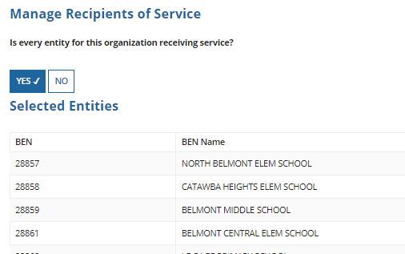
Category 2 Form 471
Provide costs.
After clicking on “Save & Continue”, you will indicate the Recipients of Service.

Slide 37
Verify information.
If correct, click on “Continue”
Add additional FRNs if needed. If done, click on “Continue”. You will then review and certify as before.

Slide 38
Connectivity Questions
Have you answered the connectivity questions?
All entities MUST have these answered.
Best Practice: do this BEFORE you begin your 471.
You may get an error during the 471 if any entity is missing connectivity data.
Save 471, go out to RELATED ACTIONS, MANAGE CONNECTIVITY QUESTIONS, then go back to TASKS and pick up where you left off on 471.

Slide 39
Where do I find my 471?
Click on Tasks, you will see your DRAFT
Click on the Link and download your DRAFT
If okay, move on to certify, if not EDIT FORM 471
Print your DRAFT (digital or paper or both!)

Slide 40
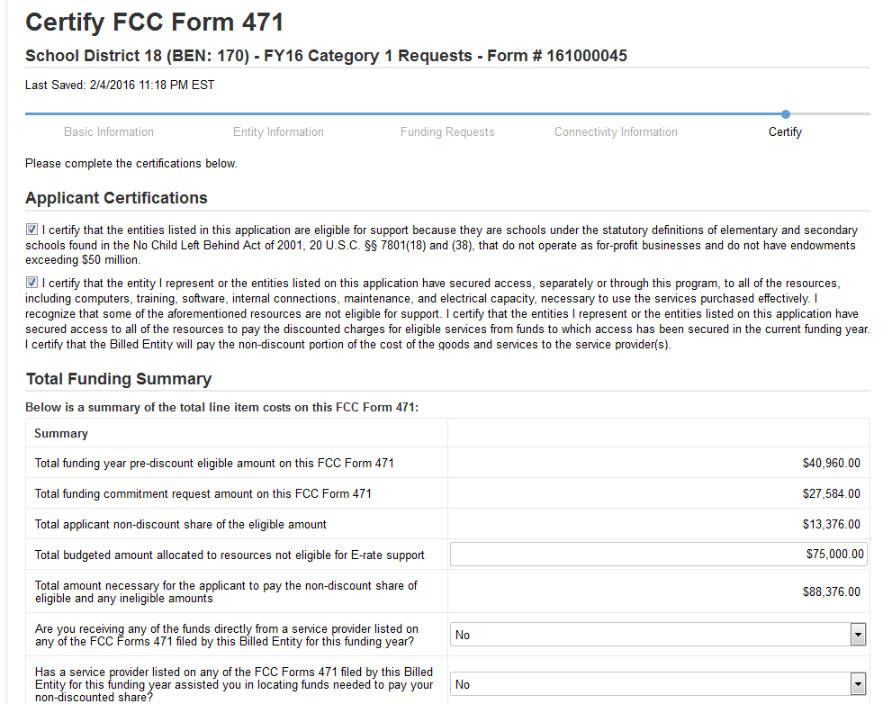
Certifying the Form 471
Read certifications, check boxes.
Enter your total budgeted amount allocated to resources not eligible for E-rate
Click the drop downs to answer the new “gotcha” questions.
Be very careful!!
Notes:
Budgeted amount can be a big number; it cannot be zero. Be careful on those gotcha questions!

Slide 41
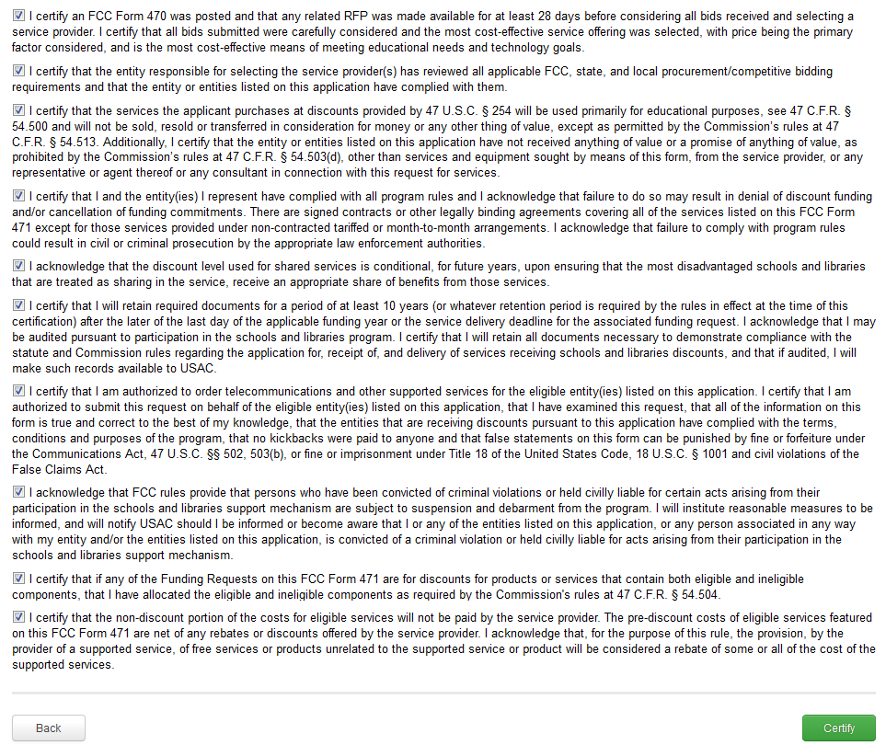
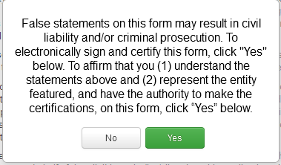
Certifying the Form 471
Continue reading certifications, check boxes.
When ready, click “Certify”, and then “Yes” in the pop-up.

Slide 42
Where did it go?
Go to your Landing Page
Form Type: 471
FY: 2018
Your form will pop up and you can download.

Slide 43
Don’t Panic!

Slide 44
Contact Information
E-Rate Support and Information
Jeannene Hurley, Northeast, North Central, Southwest and Western
jeannene.hurley@dpi.nc.gov
or
Rebecca Martin, Southeast, Sandhills, Piedmont Triad and Northwest
Rebecca.Martin@dpi.nc.gov
or
Roxie Miller, West, Southwest, and Northwest
Roxie.miller@dpi.nc.gov

