Slide 1
E-Rate Modernization and School Connectivity - for Local Education Agencies NCASBO 2017
School Connectivity:
E-Rate Services Team

Slide 2
What?
…provides discounts of up to 90 percent to help eligible schools and libraries in the United States obtain affordable telecommunications and internet access.

Slide 3
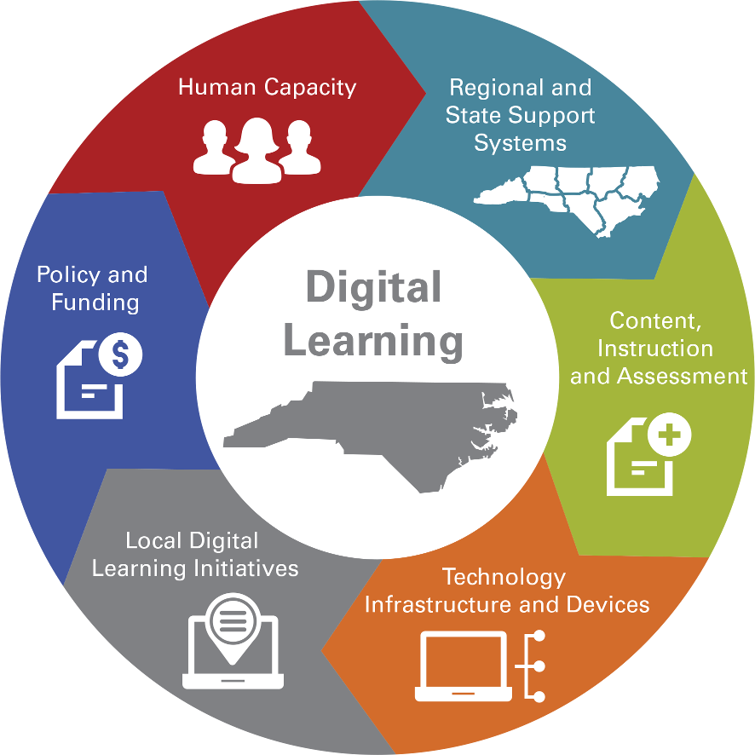
Why?
Digital Teaching and Learning
Legislation
Plan
Infrastructure
E-rate

Slide 4
Who?
Tech Director/CTO
YOU
Board of Education
Superintendent
DPI Resources
Vendor(s)

Slide 5
Me?
Budgets
Purchasing (Form 498, Contracts, RFPs)
Audits
Insurance
Financial Statements
Accounts Payable
Document Retention (10 yrs)

Slide 6
How?
School Connectivity Initiative

Slide 7
SCI
N.C. Department of Public Instruction
e-NC Authority
N.C. Office of Information Technology Services
Friday Institute
MCNC

Slide 8
SCI
Expand the number of schools with broadband Internet access
Further develop communication networks for rural and underperforming schools
Aid in professional development
Develop a scalable model to maintain and enhance network services to all schools in North Carolina.

Slide 9
“High-speed broadband connections to schools and advanced Wi-Fi inside classrooms have become essential tools for teachers and students. A major conclusion of the FCC's recent modernization of the E-rate program is that local jurisdictions benefit substantially from state-level assistance in the design, procurement, and ongoing support of this complex communications infrastructure. In our nationwide review of state approaches, we found North Carolina's model to be one of the most effective in the country. State-level support in North Carolina not only with matching financial resources but also purchasing and technical expertise from a dedicated professional staff at the state level has had a major positive impact for schools across North Carolina that stands out as a leading national example.”
Jon Wilkins
Chief of the Wireless Telecommunications Bureau
Former Managing Director
Federal Communications Commission

Slide 10
Voice
If your discount is… | Then your voice discount will be:
 | FY 2015 | FY 2016 | FY 2017 | FY 2018 | FY 2019
20% | No Funding | No Funding | No Funding | No Funding | No Funding
25% | 5% | No Funding | No Funding | No Funding | No Funding
40% | 20% | No Funding | No Funding | No Funding | No Funding
50% | 30% | 10% | No Funding | No Funding | No Funding
60% | 40% | 20% | No Funding | No Funding | No Funding
70% | 50% | 30% | 10% | No Funding | No Funding
80% | 60% | 40% | 20% | No Funding | No Funding
90% | 70% | 50% | 30% | 10% | No Funding

Slide 11
Internet
Category 1
NCREN managed by MCNC
State network
Free, high speed
E-rate Category 1 filed by DPI
LEAs file for WAN
PRC 073

Slide 12
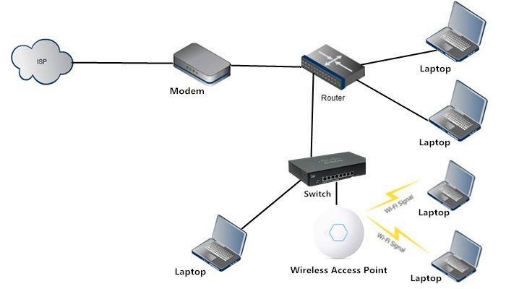
Internal Connections
Category 2
State Contracts
E-rate and SCI funds
Allocation per ADM
5 years
PRC 073

Slide 13
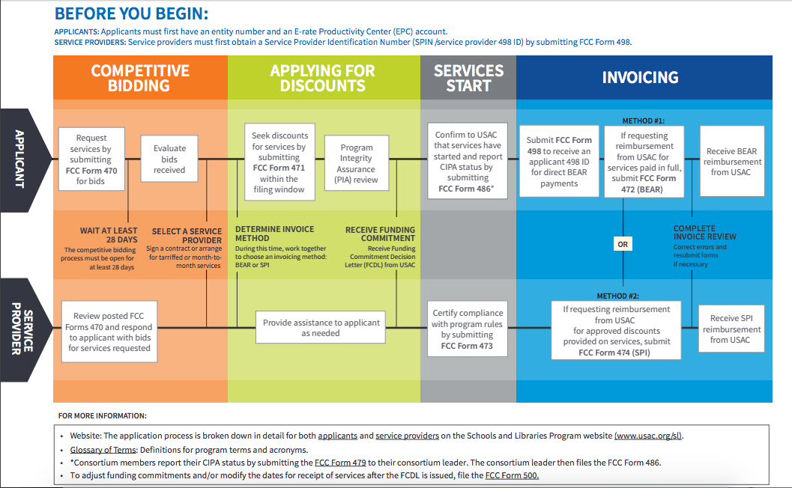
Filing for E-rate

Slide 14
Records retention

Slide 19
Direct Deposit!
Form 472, BEAR, is now a direct deposit to the applicant’s bank account
CFO must have a role in EPC
Form 498 – completed by “School or Library Official”

Slide 20
Data Needed
Banking Information
Bank Name
Ban Routing Number
Bank Account Number
DUNS
Dunn and Bradstreet Number

