Slide 1
Generate your FCDL

Slide 2
Notification
From: EPC Application Administrator ‪<EPC.Application.Administrator@usac.org>‬
Date: Sat, Jul xx, 2017 at 12:03 AM
Subject: EPC Notification - E-rate Funding Commitment Decision Letter (FCDL) available for Application 1701xxxxxxx
To:
Hello,
The Funding Commitment Decision Letter (FCDL) for application xxx (School District WAN 201xx-xx), filed by XXX COUNTY SCHOOL DISTRICT (BEN: xxxxxx), has been issued. To view the FCDL, login to USAC’s E-rate Productivity Center (EPC) by clicking on the link below. From your landing page, navigate to the Notification Center and click on Generate Notification for this application. If the notification has already been generated, you will instead see a link that says View Notification; click on View Notification or navigate to your News Feed to view the FCDL details.
Login to EPC
If you have questions, or believe that you received this notification in error, please Contact Us or call the USAC Client Service Bureau at (888) 203-8100 for assistance.
Thank you,
Universal Service Administrative Company

Slide 3
Landing Page
From Notification Type, Choose FCDL. Then Choose 2017as the Funding Year
Click Generate Notification

Slide 4
View Notification
Click View Notification

Slide 5
FCDL (part 1)
E-Rate Productivity Center Thank you for your Funding Year 2016 Application for Universal Service Support and for any assistance you provided throughout our review.
This post contains your Funding Commitment Decision Letter for the FY 2016 FCC Form 471 Application Number xxxxxxx for XXX SCHOOL DISTRICT – BEN xxxxxx. The attached .csv file contains information about the committed status of the funding requests, and the FCDL Supplement contains additional important information. The FCDL date is 7/23/20xx.
Please open the .csv file below for complete details about the commitments made for each of the Funding Requests. This file can be opened in any spreadsheet program. O make the information easier to read, first select the entire spreadsheet and then expand all of the the columns in the document (in Excel, double click on the divider between the column headings, A,B, etc).
We are also sending this information to your service providers so that preparations can begin for delivering services based on the approved discount(s) after you file your FCC Form 486, Receipt of Service Confirmation Form.
The FCDL Supplement document provides more important information including steps for appealing USAC’s funding decisions.
The “More Info” link below provides summary data about the commitments made to your company in this wave. Click on the date/time below to display the entire notification for easy printing.
Please print this page using your browser’s print function

Slide 6
Next Steps and Supplement
Next Steps:
-Work with your service provider to determine if you will receive discounted bills or if you will request reimbursement from USAC after paying your bills in full.
-Review the Children’s Internet Protection Act (CIPA) requirements.
-File the FCC Form 486 once you are ready to begin receiving services.
-If you are paying the full bill, invoice USAC using the FCC Form 472, Billed Entity Apploicant Reimbursement (BEAR) Form.
Please print and save your Supplement Document!

Slide 7
Click CSV hyperlink
Click this hyperlink to open the CSV file in Excel.

Slide 8
Edit Excel File
CSV file opens automatically in Excel.
Manipulate the worksheet to view all the column headings and column data.
Use the “transpose” feature in Excel to change from a long row to a columnar format
Be sure you see your pre-discount funding amount in COLUMN S, your discount rate in COLUMN T, and your committed amount in COLUMN U.

Slide 9
Column W
Check for any commitment adjustment comments!
We are hoping that all comments say:
MR1: Approved as submitted.
Save your .csv file!!!

Slide 10
Blue Hyperlink
This link, once again, simply takes you to the Summary Page of the application.

Slide 11
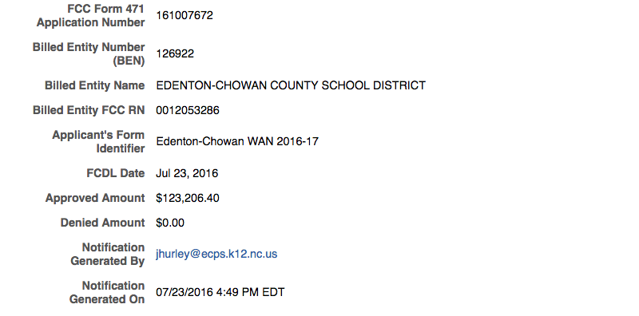
Summary of FCDL
At the bottom of the FCDL notification, you’ll see this list of data. You can use your browser’s print function to print this entire page.

Slide 12
Return to Landing Page
Click the “matrix” in the top left to get to your home page.

Slide 13
Ready to start service?
C1 - Continue to file the 486
C2
If you are ready for C2 installs or to purchase gear / service, AND you are using the DPI Form 470 for your WiFi purchases, we will deposit the non-discounted portion of your project into your PRC 073 (LEAs) or PRC 036 (charters)
Continue to file the 486

