Slide 1
Filing the FCC Form 470
Special thanks to Julie Trent Schell (E-rate PA)
and Anne Perloff (E-rate ME)

Slide 2
When to file?
File a 470 when you are seeking new contracts for services OR month-to-month services
Not required when using contract extensions on existing contracts
Category 2 contracts already covered by DPI
At least 29 days before the 471 window closes
Suggest by Halloween or early-mid November
Don’t know 471 dates yet

Slide 3
Purpose of 470?
Online form to notify vendors of services and equipment for which you are seeking proposals
All equipment/services for which you will seek funding on the Form 471 must have been posted on a Form 470
You are NOT obligated to purchase any service/equipment listed on Form 470, may cancel

Slide 4
470 Requirements
Cannot be manufacturer-specific
Can list preferred manufacturer, but must include the words, “or equivalent”
Can require equivalent bids must be “compatible with district’s existing [???] equipment”

Slide 5
RFP Notes
Must be uploaded with Form 470 at time of filing
Addenda also must be uploaded later
Not required, except for:
Minimum state bidding threshold requirements
All applicants applying for dark fiber or construction of fiber procurements
Vendors cannot provide RFP language or bid lists

Slide 6
Before you file…
EPC user name and password
Check entities on landing page…all there?
New entities added/deleted through USAC
List of needs/services ready
Timeline
Formal RFP ready (if using)

Slide 7
Where do I file?
In EPC (USAC portal)
portal.usac.org
Should have user ID and password from USAC before you file

Slide 8
How many do I file?
Category 1 and Category 2 can be filed on the same 470, but not a requirement
C1 and C2 requests must be on different 471s

Slide 9
Filing a Form 470

Slide 10
Filing a Form 470

Slide 11
Filing a Form 470

Slide 12
Filing a Form 470

Slide 13
Filing a Form 470

Slide 14
Filing a Form 470

Slide 15
Filing a Form 470
Beware of the Black hole!

Slide 16
Filing a Form 470

Slide 17
Basic Information
Form 470: Part 1

Slide 18
Filing a Form 470
Full school/district/library name

Slide 19
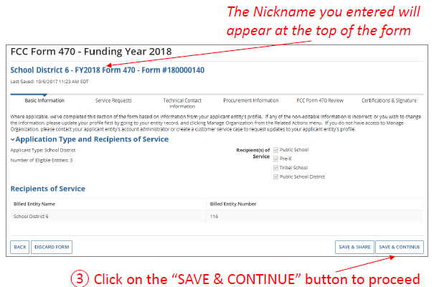
Filing a Form 470

Slide 20
Filing a Form 470

Slide 21
Filing a Form 470
Who is the main contact person?

Slide 22
Service Requests
Form 470: Part 2

Slide 23
Filing a Form 470

Slide 24
Filing a Form 470

Slide 25
Filing a Form 470
In other words, you will assign the RFP documents to appropriate service requests.

Slide 26
Filing a Form 470

Slide 27
470 & RFP Requirements
All applicants seeking the following services MUST issue an RFP:
Leased Dark Fiber
Self-Provisioned Fiber
C1 Network Equipment
Maintenance and Operation of Leased Dark or Self-Provisioned Fiber
All RFPs and related documents must be uploaded with the 470, cannot just provide a link
All subsequent material provided to vendors must be uploaded to the RFP/470 in EPC
28-day clock must be restarted if material changes are made to the RFP, “Cardinal Changes”

Slide 28
Filing a Form 470

Slide 29
Filing a Form 470

Slide 30
Filing a Form 470

Slide 31
Filing a Form 470

Slide 32
Filing a Form 470

Slide 33
Filing a Form 470

Slide 34
Category 1 Drop Down

Slide 35
Filing a Form 470
New Bundled Internet Requirement
Beginning in FY 2018, if you are seeking Internet with Fiber Transport, you must include 2 service requests:
Internet Access and Transport Bundled, AND
Leased Lit Fiber
Then explain in the narrative section that you are not seeking a Lit Fiber WAN, but instead are simply seeking Internet Access that is delivered via Fiber

Slide 36
Leased Lit Fiber

Slide 37
Self Provisioned Network

Slide 38
Leased Dark/Leased Lit Fiber

Slide 39
Internet w/ Transport

Slide 40
Transport Only, No ISP

Slide 41
Filing a Form 470

Slide 42
Filing a Form 470

Slide 43
Filing a Form 470

Slide 44
Filing a Form 470

Slide 45
Filing a Form 470

Slide 46
Technical Contact Information
Form 470: Part 3

Slide 47
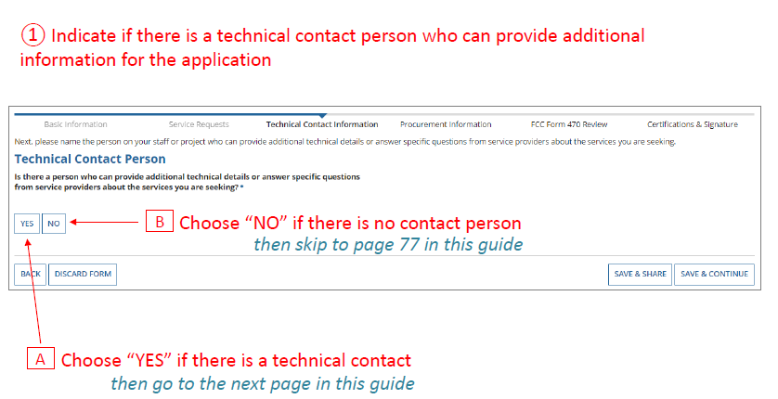
Filing a Form 470

Slide 48
Filing a Form 470

Slide 49
Filing a Form 470

Slide 50
Filing a Form 470
Click Save & Continue when done

Slide 51
Procurement Information
Form 470: Part 4

Slide 52
Filing a Form 470

Slide 53
Filing a Form 470
Always select YES!
Then use the narrative box to provide additional requirements/instructions to vendors
For example:
All bids must be submitted to ?? person by ?? date in ?? format
Vendor must provide discounted bills
Vendor must submit 3 references of district officials where identical services were provided within last 2 years
Vendors must attend pre-bid meeting on ?? date

Slide 54
Reviewing Your 470
Form 470: Part 5

Slide 55
Filing a Form 470

Slide 56
Filing a Form 470

Slide 57
Filing a Form 470

Slide 58
Filing a Form 470

Slide 59
Filing a Form 470

Slide 60
Filing a Form 470

Slide 61
Filing a Form 470

Slide 62
Where is my Form 470?
Go to EPC Landing page
Scroll down to bottom
Select Form 470
Select funding year
Select 470 number
Selected “generated documents” from summary page
Click on “original version”, will open in PDF format

Slide 63
Filing a Form 470
PRINT
PRINT
PRINT
PRINT

Slide 64
Special Notes
Watch for e-mails and portal notifications for inquiries!
Respond immediately!
Do not provide information to individual vendors, all vendors should receive same information

Slide 65
Filing the FCC Form 470
Jeannene Hurley jeannene.hurley@dpi.nc.gov [252-624-9878]
Rebecca Martin rebecca.martin@dpi.nc.gov [303-304-4261]
Roxie Miller roxie.miller@dpi.nc.gov [980-285-3551]
Mike Ramsey michael.ramsey@dpi.nc.gov [828-278-9770]

