Slide 1
Charter Schools and E-Rate
Jeannene Hurley 252-624-9878
Rebecca Martin 303-304-4261
Roxie Miller 980-285-3551
Mike Ramsey 828-278-9770

Slide 3
What is it?
Created as part of the Telecommunications Act of 1996
Funding generated through the Universal Service Fund
$3.9 billion annual budget
All schools and libraries eligible to participate
Two categories of service

Slide 4
Category 1
Internet Access
Data Transmission
Voice (90% schools only)

Slide 5
Category 2
Internal Connections
Access Points
Routers
Switches
Cabling
Racks
UPS
Basic Maintenance of Internal Connections
Managed Internal Broadband Services

Slide 6
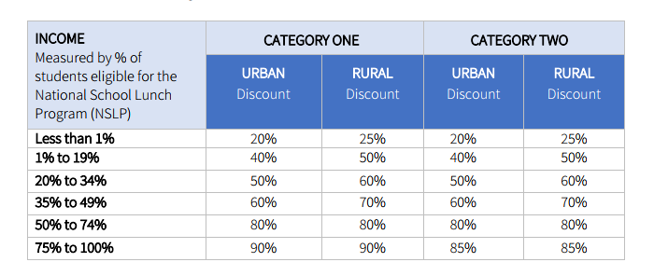
Discount Matrix

Slide 7
How do I get funding?
Category 1
Internet
NCREN (state network, free)
Free firewall, content filter
May apply for own Internet
Second connections?
Need to file now!
PRC036

Slide 8
How do I get funding?
Category 2
School budget (5 year)
ADM x FCC Multiplier ($153.47)
State contracts/vendors
Forms and process
100% covered by E-Rate and NCDPI
PRC036

Slide 9
To get started….
Contact information
Northeast Region, North Central,
Jeannene Hurley, jeannene.hurley@dpi.nc.gov
Southeast, Sandhills, Piedmont Triad
Rebecca Martin, rebecca.martin@dpi.nc.gov
Southwest, Northwest, West
Roxie Miller, roxie.miller@dpi.nc.gov

Slide 10
LINKS
Eligible Services List for 2018 https://www.fcc.gov/document/wcb-releases-eligible-services-list-e-rate-funding-year-2018
Selecting a Service Provider
http://www.universalservice.org/sl/applicants/step02/default.aspx
E-Rate Handbook
https://docs.google.com/document/d/1VDQbFvjkgZ3EqcCBbpQY6mzCV4F8_oNh4P5QjqjlL_I/edit

Slide 11
REMINDERS

Slide 12
FILE Form 470’s NOW!
Determine needs for FY 2018-2019
Use Eligible Services List as a guide (ESL)
Prepare Request for Proposal (RFP) (if needed)
File Form 470
If RFP is being used, it MUST BE UPLOADED with Form 470
A minimum of 28 days is required before opening and evaluating bids begins

Slide 13
After Bids Are Received
Preparing for Vendor Selection
Evaluate bid responses
Use matrix with price being primary weighted factor
Document each bid response according to your organization’s policies / procedures
Document the date meeting is held, ensuring a minimum of 28 days has elapsed after Form 470 was posted
Document meeting attendees and any minutes of the meeting
Present the proposals to the Board (if needed)
Sign contracts – pay attention to the DATES!
Calculate discount (with school nutrition)
Prepare to file FORM 471

Slide 14
2017 -REMINDER Generate your FCDL/486
We are sending data on awards every week to NCDPI finance so it should be a relatively quick turnaround. We have "net 30" payment terms on our contracts, so you could
Generate your FCDL and PRINT
File the 486
Create and send the PO to your vendor
Get your gear (and or installation scheduled)
Receive PRC money
Pay your vendor their “non-discounted” money

Slide 15
2017 Reminder EPC, PIA and PQA
Answer all questions in EPC as quickly as possible
Contact your Regional E-rate Specialist for issues:
With your PIA or PQA reviewer
Submitting responses in EPC
Adding your CFO in the portal, filing 498 or uploading bank verification

